Slide 1
Microsoft presents What is new in analytics for Business Central in 2025 release wave 1

Slide 2
Abstract (hidden slide)
Join this session for the grand overview of key updates to analytics in Business Central 2025 release wave 1, including Power BI apps, data analysis queries, and reports with Excel/Word layouts. We will cover this and how it works across all major functional areas: finance, sales, purchasing, manufacturing, projects, and more. The session is relevant if you work pre-sales, as this demos well with prospective and existing customers, or working as functional consultants (to show your customers what is possible), architects (to include analytics in upgrade plans and tenders), and maybe also developers (to learn where to get inspired for your code).

Slide 3
Agenda
Framing the analytics story
Discover and explore reports
What’s new in…
Finance
Sales
Manufacturing
…
Data analysis new features (Peter)
Learn more

Slide 4





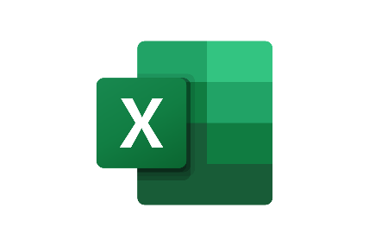



Typical analytics needs in organizations
Typical ways to consume data
KPIs
Dashboards
Financial reports
Data aggregation
Performance data
Leadership
Trends, summaries
Organizarional hierachy
Management
Managerial reports
Ad-hoc analysis
Detailed
data
Staff
Operational reports
On-screen task data
Notes:
This slice shows where Power BI, Data Analysis, and Excel fit into the analytics story

Slide 5
Discover and explore reports

Slide 6
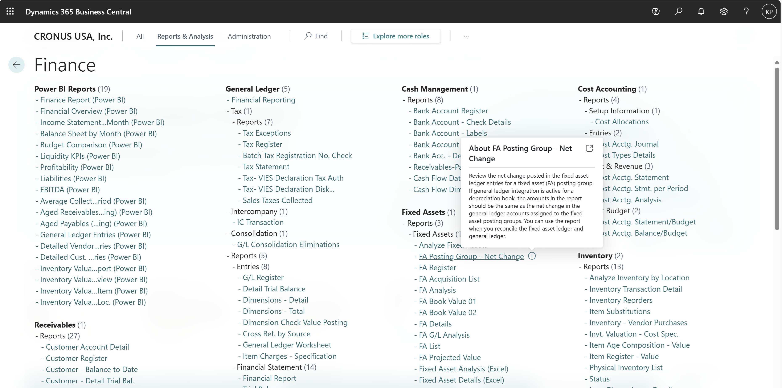
Report Explorer in 26.0 – now with info icons
Notes:
If people ask if BC has any reports…

Slide 7
Report Explorer in 26.0 – try a report in a new window
Notes:
If people ask if BC has any reports…

Slide 8
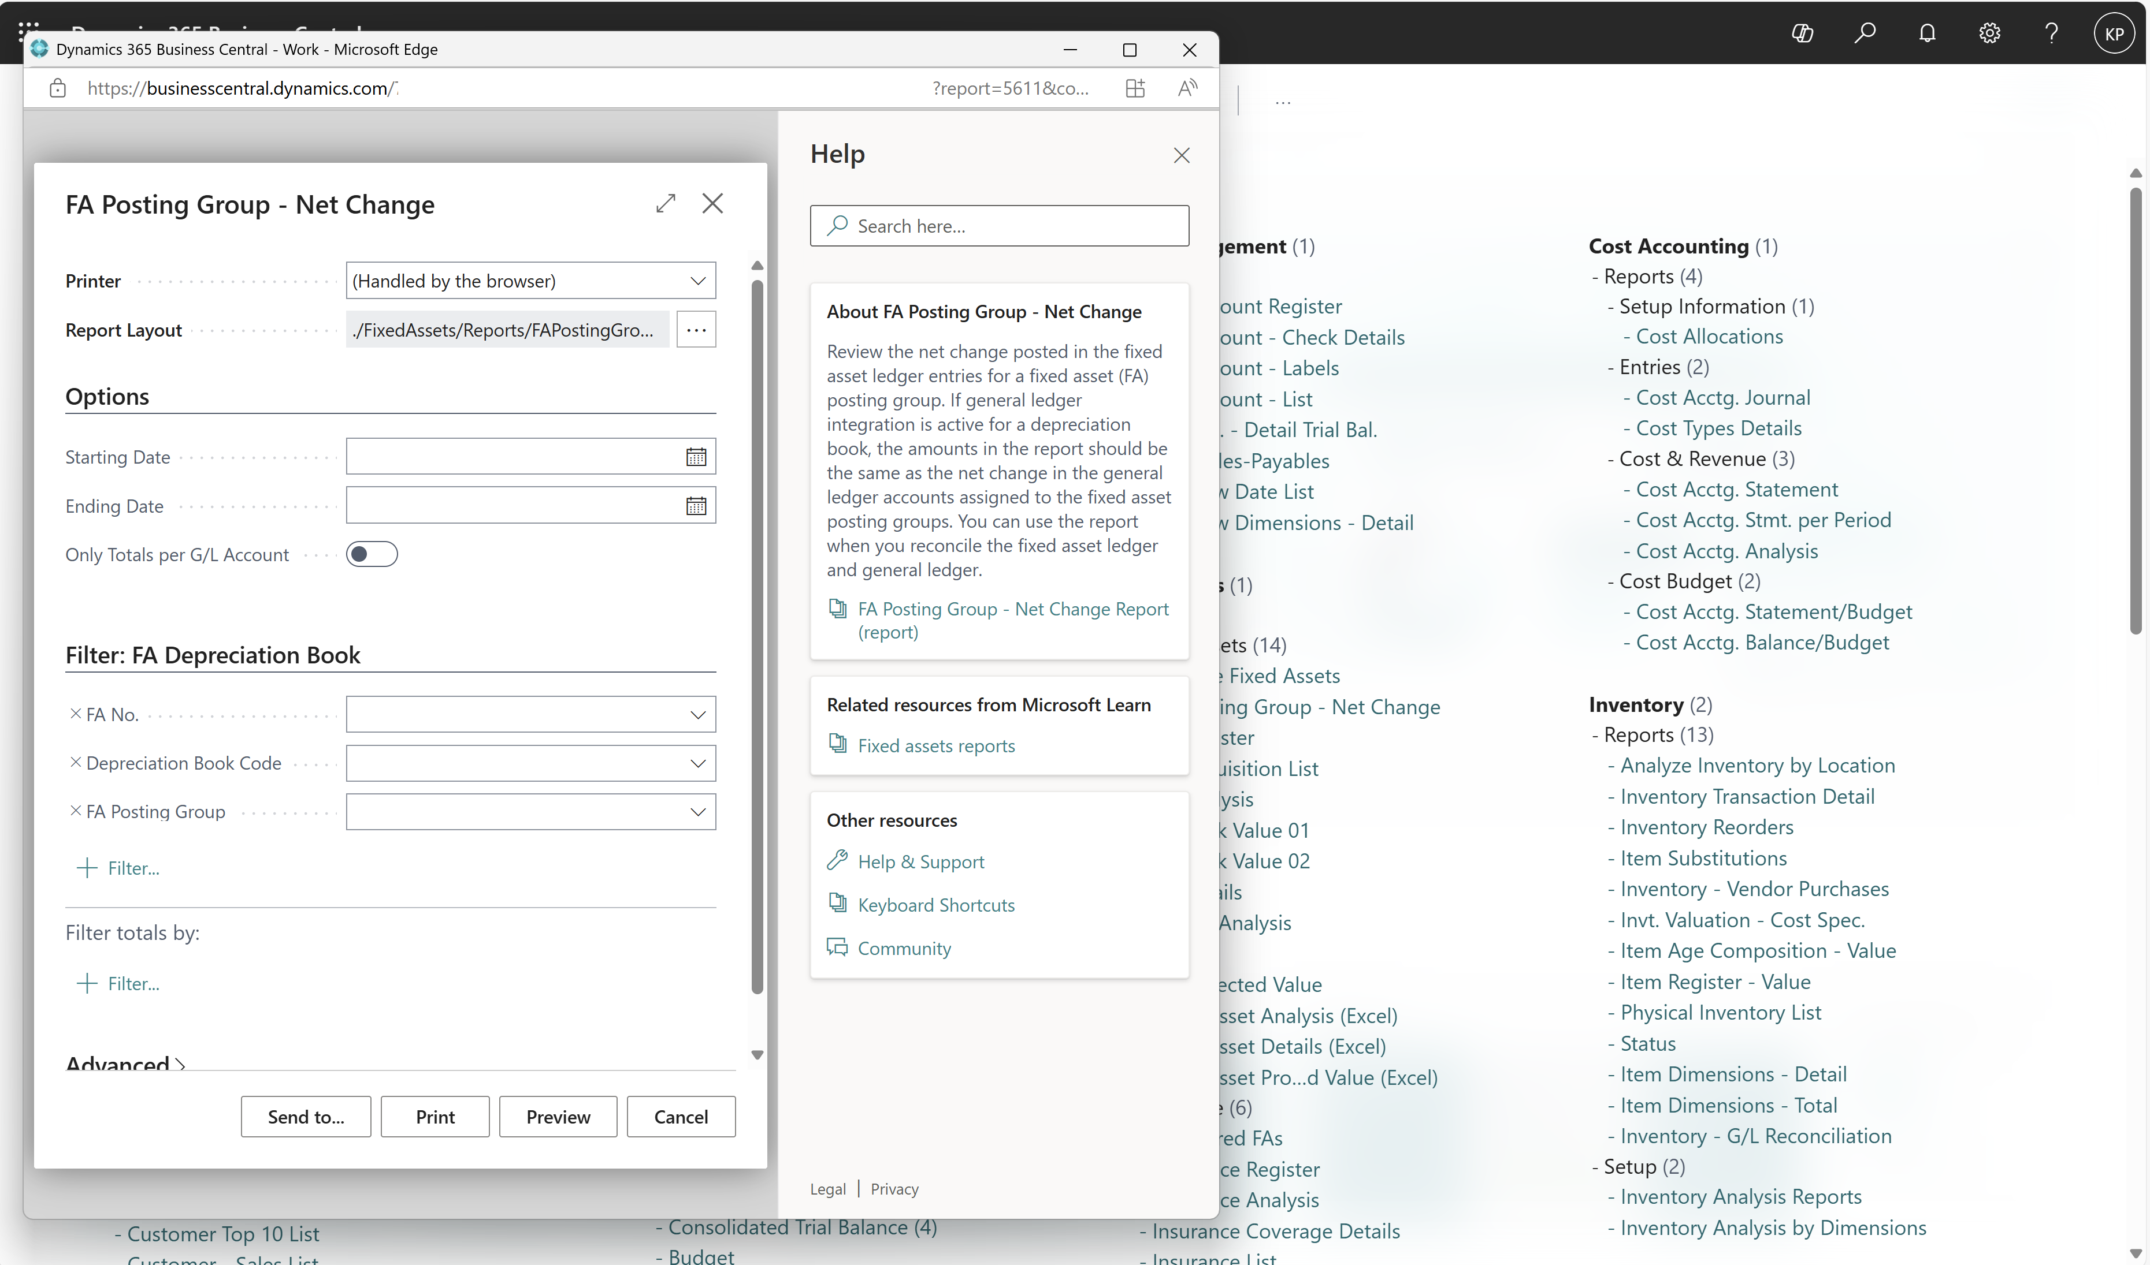
Opens report request page in a new window

Slide 9
What’s new in… Finance Manufacturing Sales …

Slide 10

Analytics enhancements in 2025 release wave 1
79 new or enhanced reports
Finance
Manufacturing
Purchasing
Financial Reporting: 10+ features
Excel reports: 7 reports
Power BI reports: 8 new, 6 updated
Excel reports: 8
Excel reports: 1
Analysis queries: 2
Subscription Billing
Sustainability
Fixed Assets
Power BI reports: 14 new
Power BI reports: 9 new
Excel reports: 3
Excel reports: 3
Analysis query: 1
Inventory
Sales
Analysis queries: 1
Power BI reports: 7 new, 5 updated
Excel reports: 1
Analysis queries: 1
Projects
Analysis queries: 2
Notes:
Improved Data Analysis
Support for Week over Week analysis
Support for element counts
Tooltips
Improved Document Reporting
Support sections in Word layouts
Support conditional formatting in Word layouts
Searching for all words rather than any substring
Significantly faster sear

Slide 11
Financial reporting for users
1
A slimmer user interface
2
Accounting format for negative numbers
3
Portrait mode PDF
4
Excel layouts

Slide 12
Financial reporting for authors
1
Internal descriptions
2
Intro/closing paragraphs
3
Row definitions
4
Column definitions

Slide 13
Financial reporting for admins
1
Telemetry
2
Microsoft Purview (coming soon)
3
Audit changes to definitions
4
Setup permissions

Slide 14
Sales analytics themes for 2025 release wave 1 (26.1)
Sales lifecycle
Profitability
Demographics
AI assisted analysis

Slide 15
Phases of a sale
Opportunity
Quote
Sales order
Sales invoice
(Return)
2024 wave 2
2024 wave 2
2025 wave 1
2025 wave 1
2025 wave 1

Slide 16
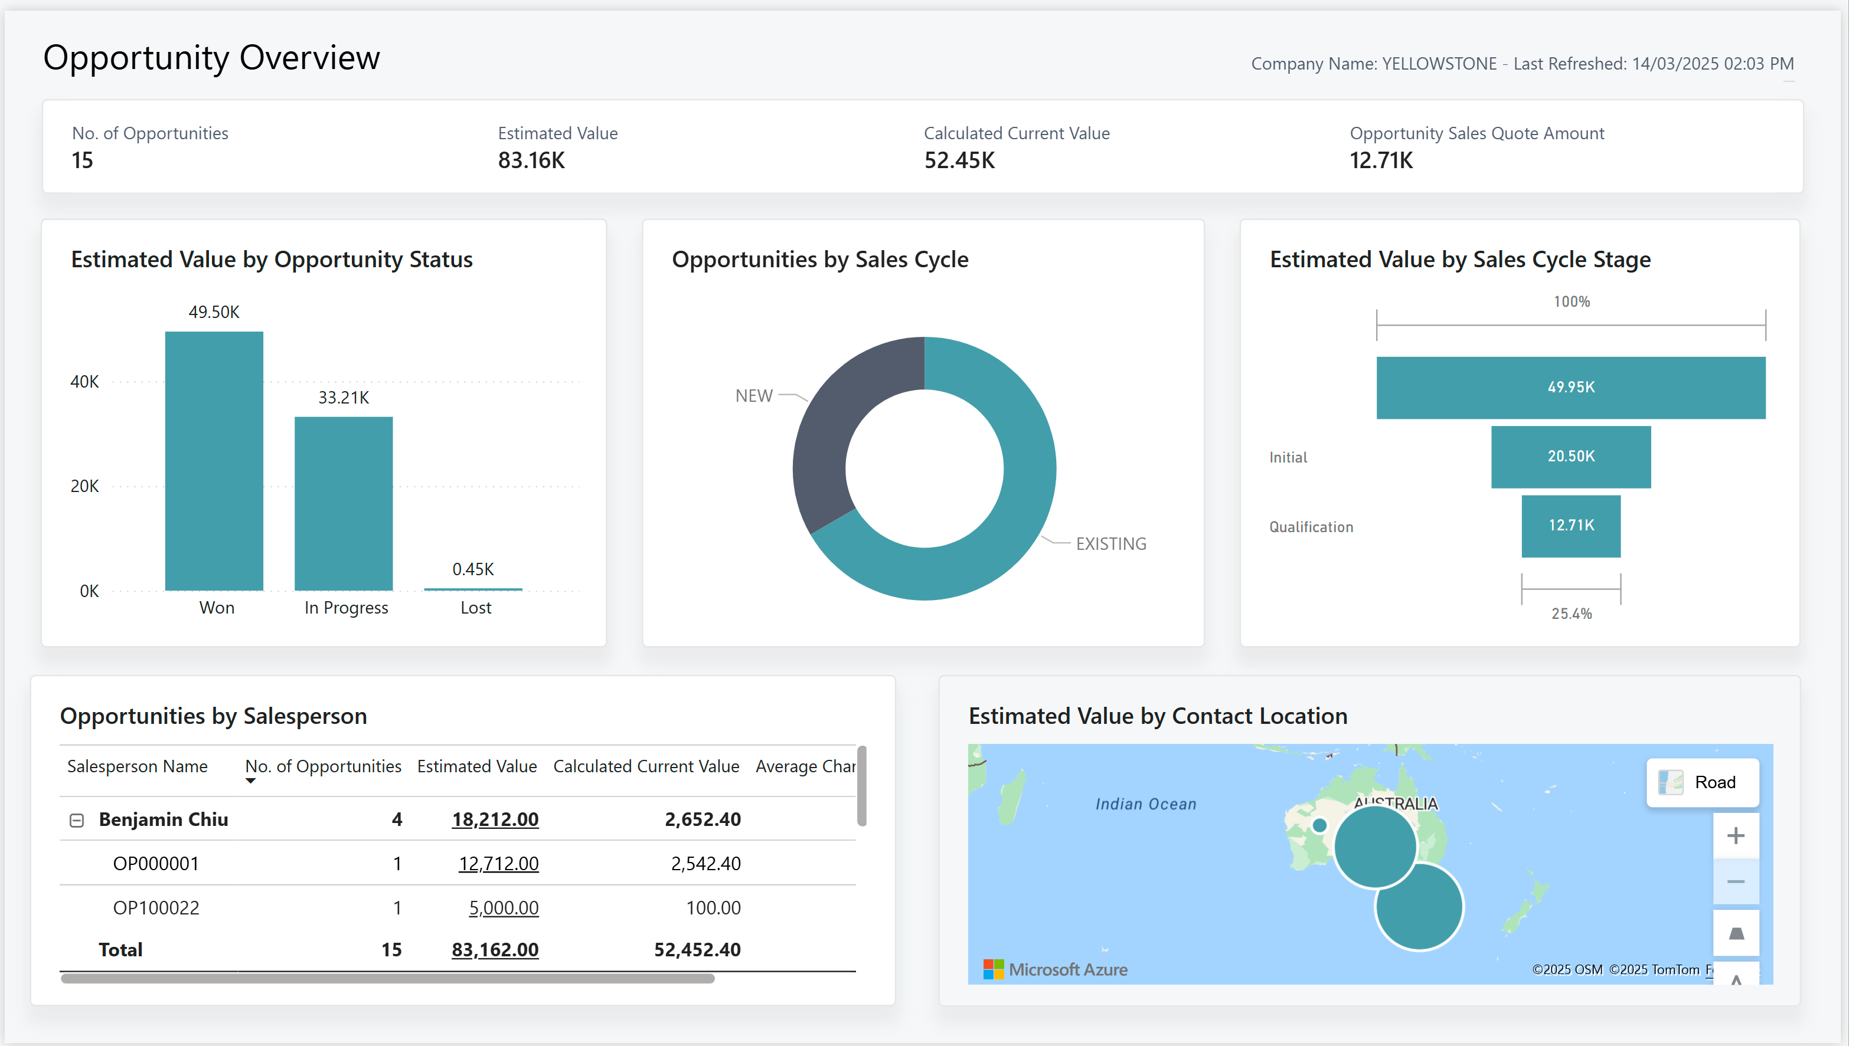

Slide 17
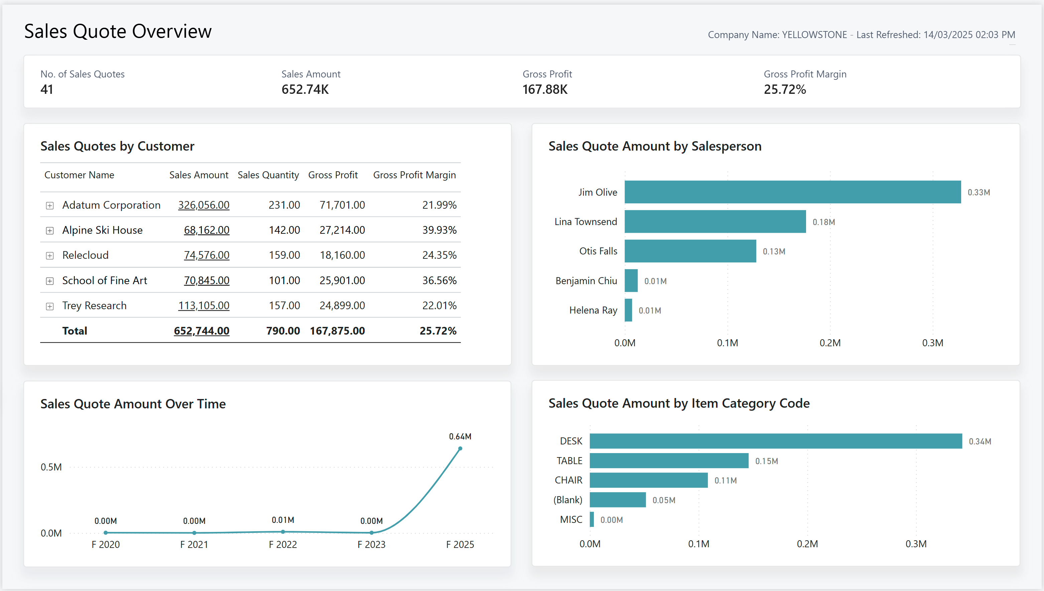

Slide 18
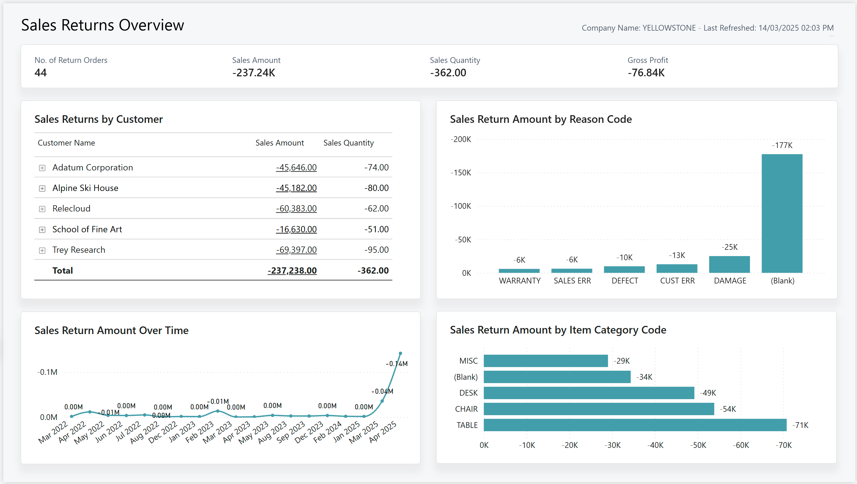

Slide 19
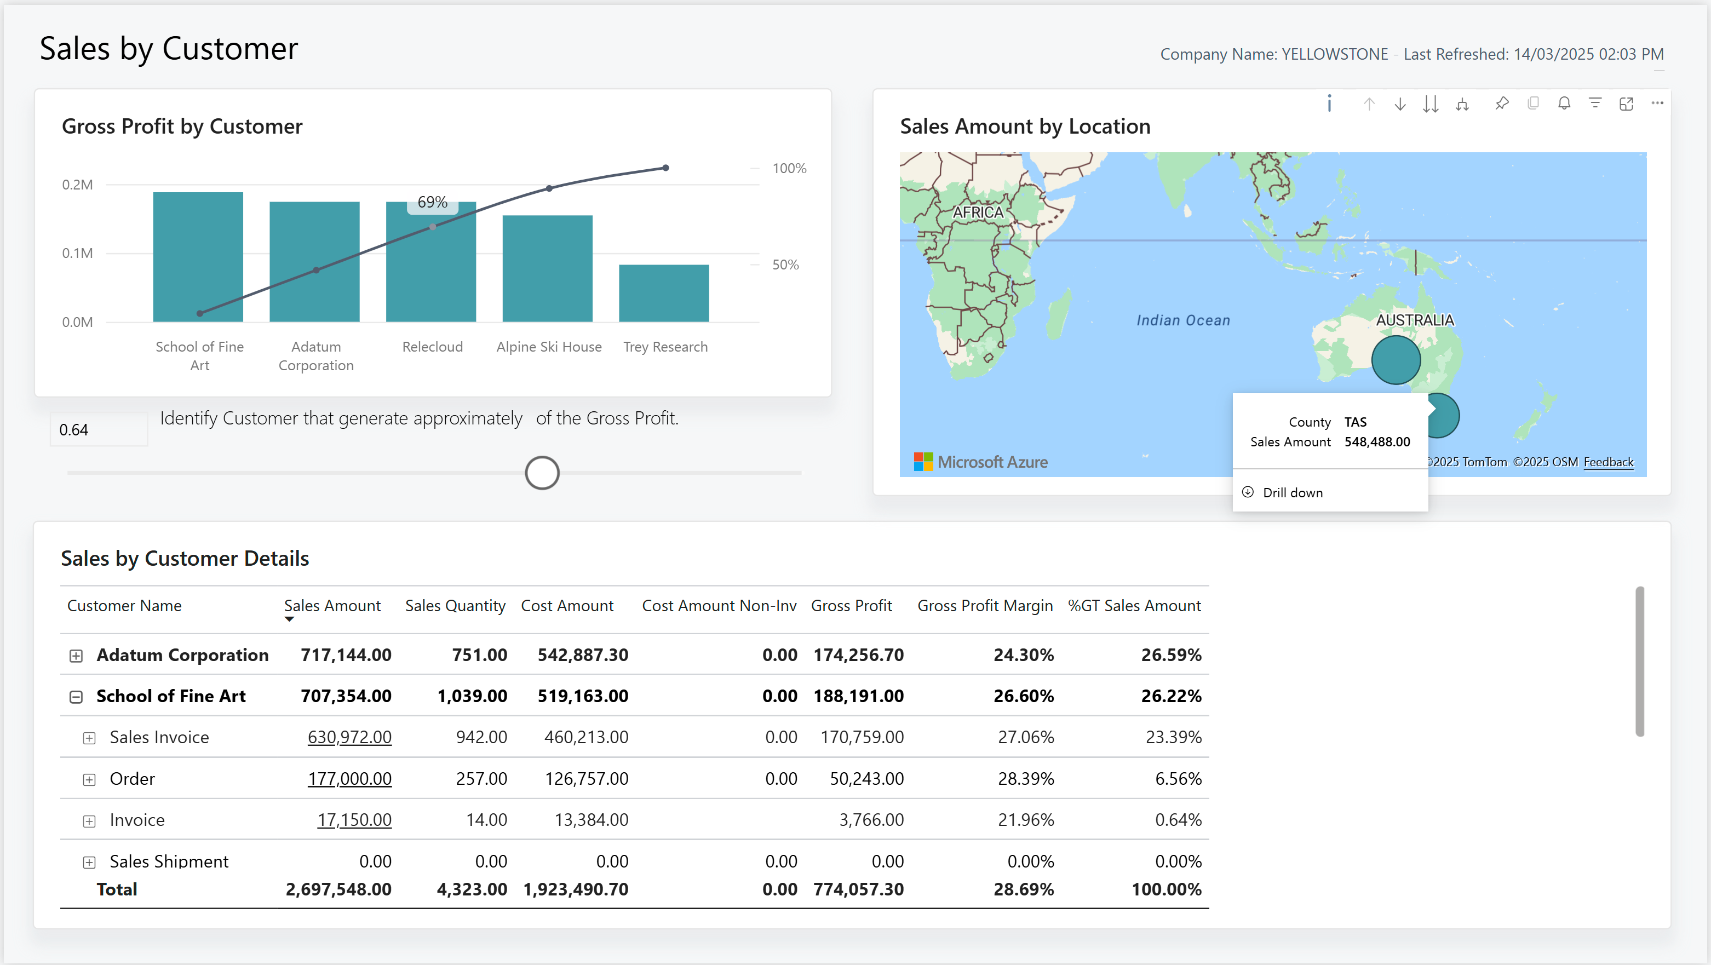
Profitability analysis (pareto)

Slide 20
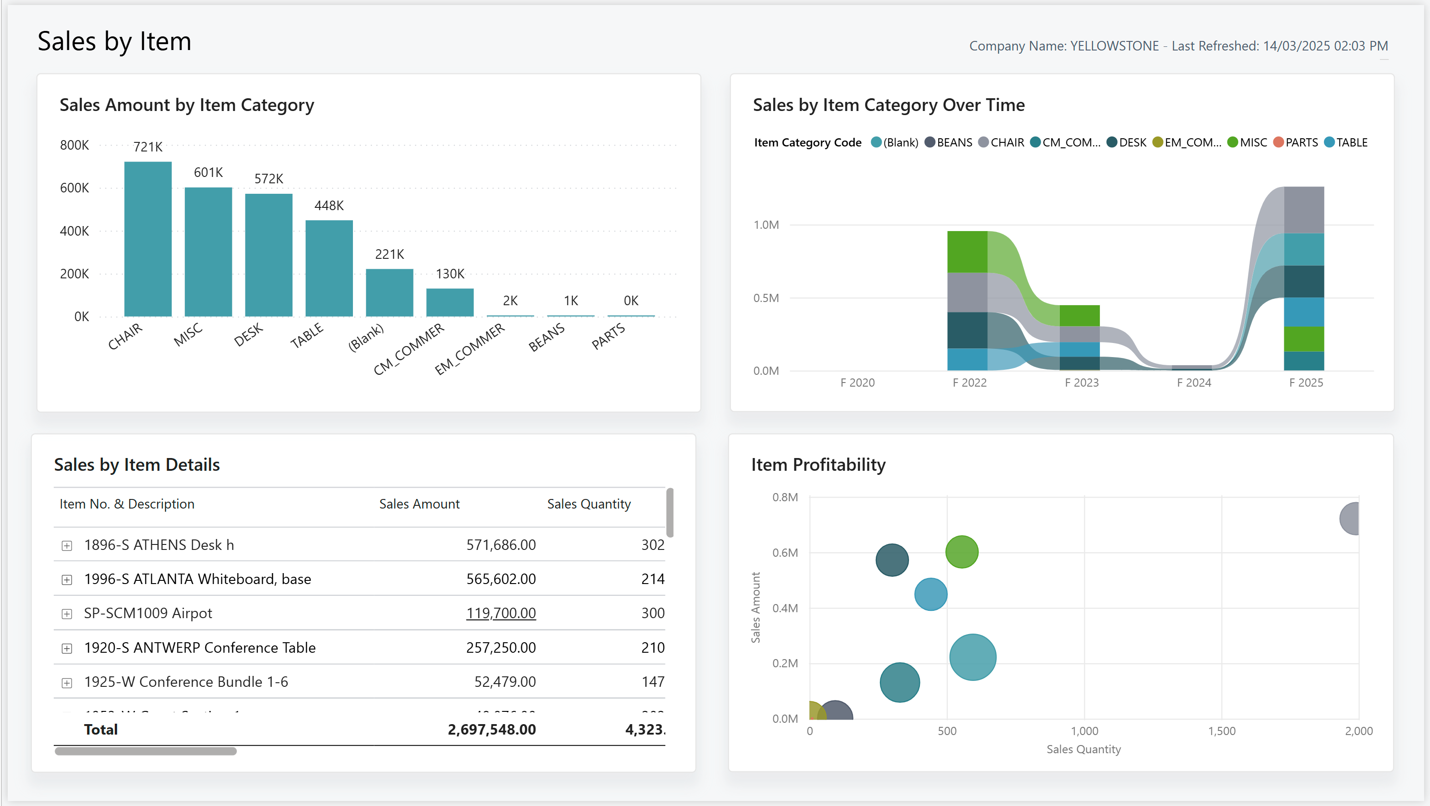
Profitability analysis (item seasonality and profitability)

Slide 21
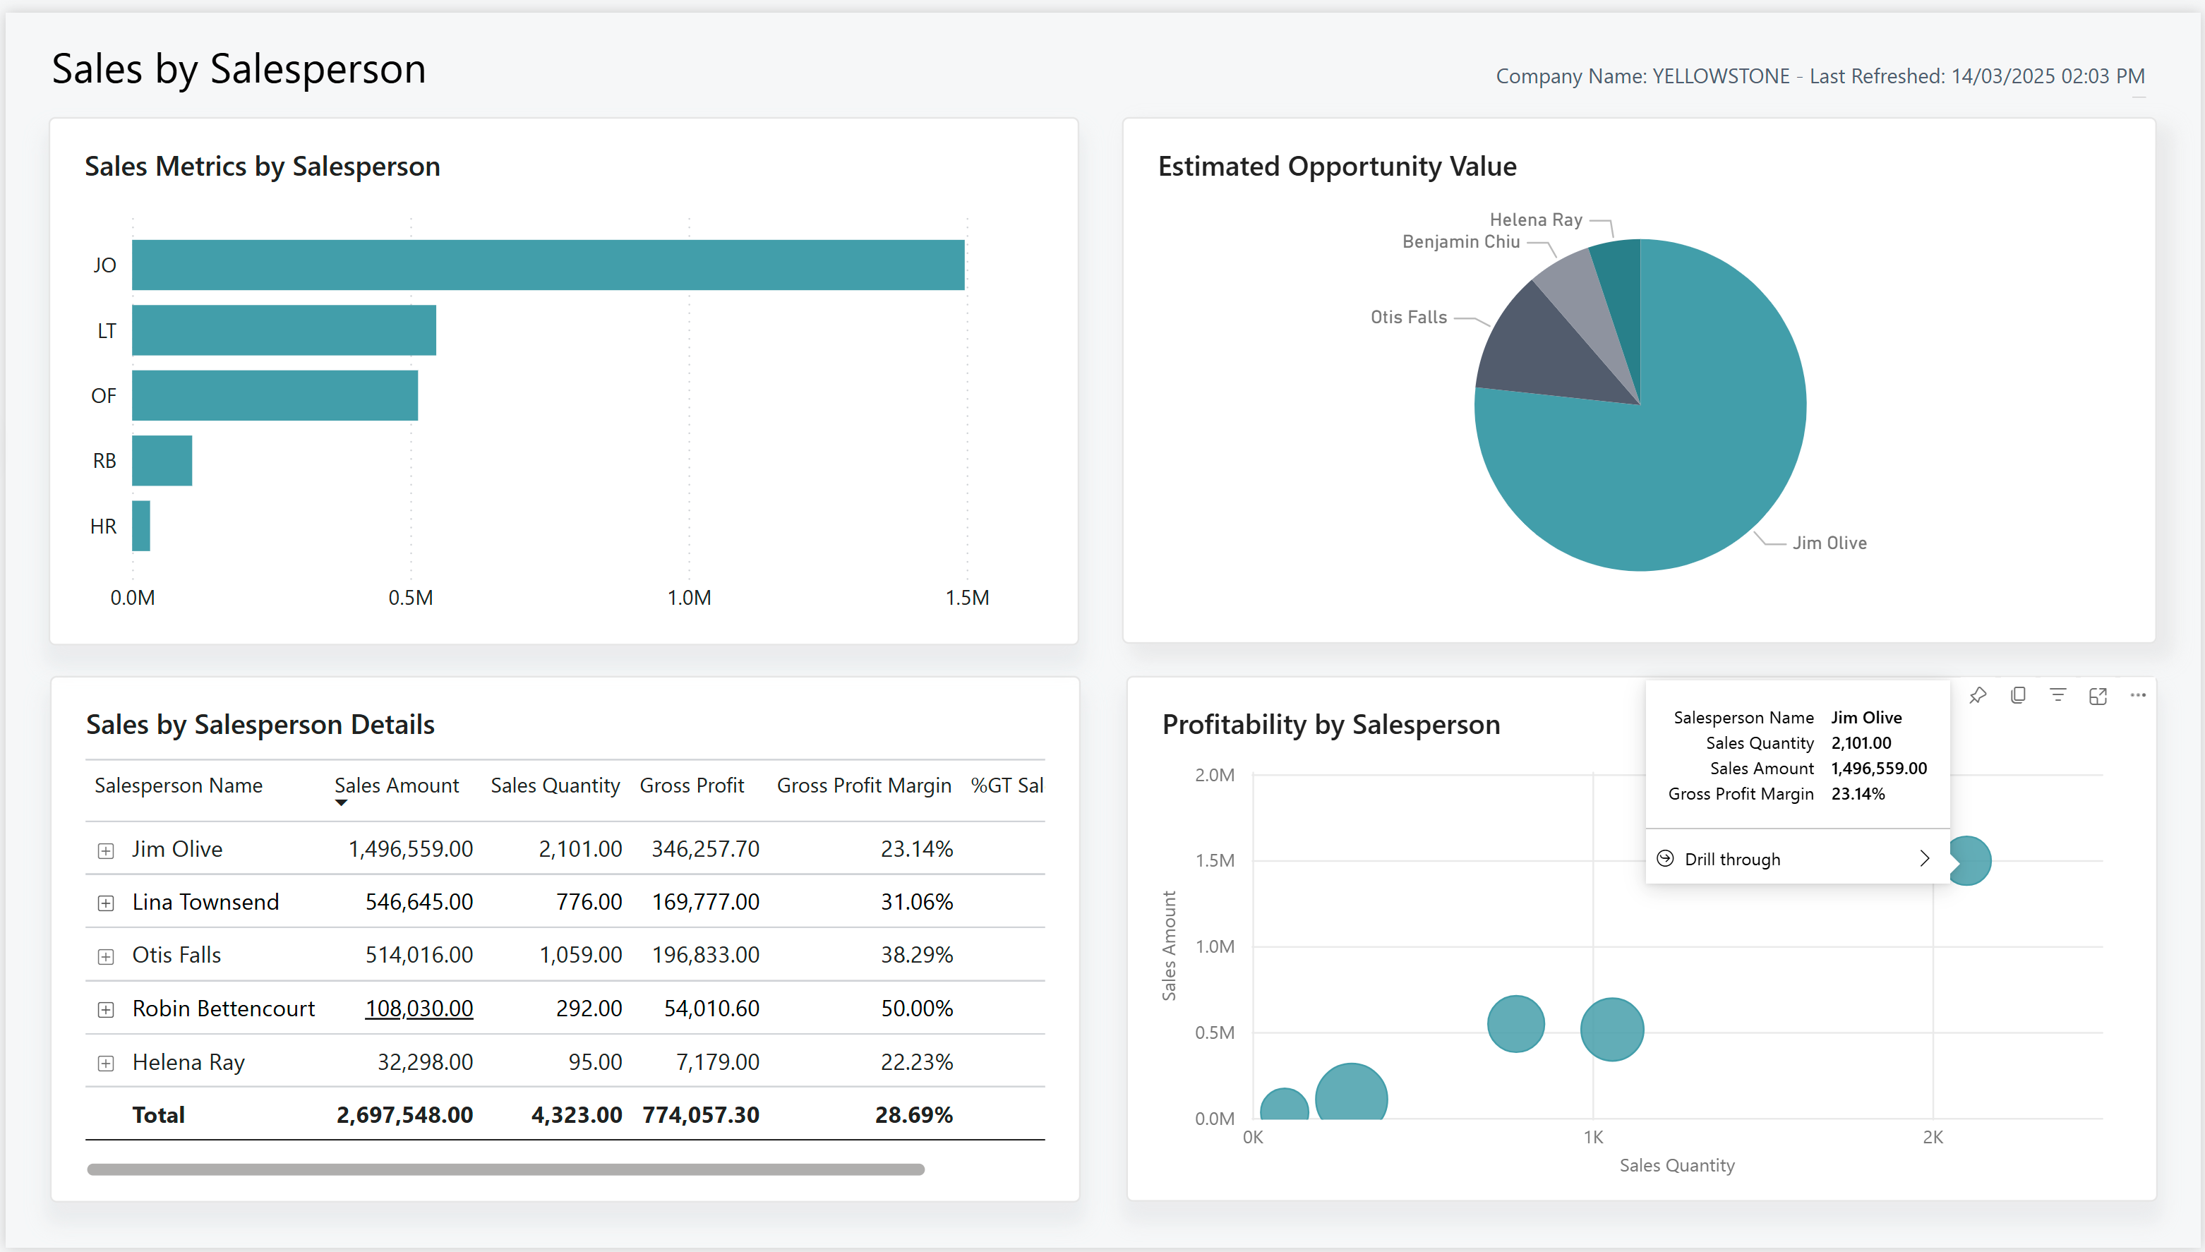
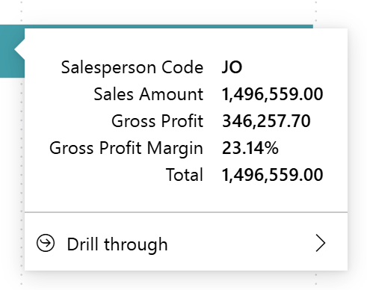
Profitability analysis (sales staff)

Slide 22
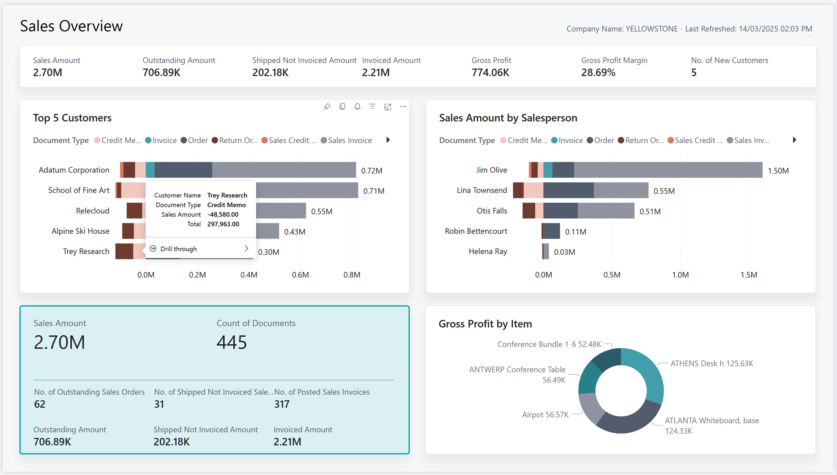
Profitability (by customer or sales staff)

Slide 23
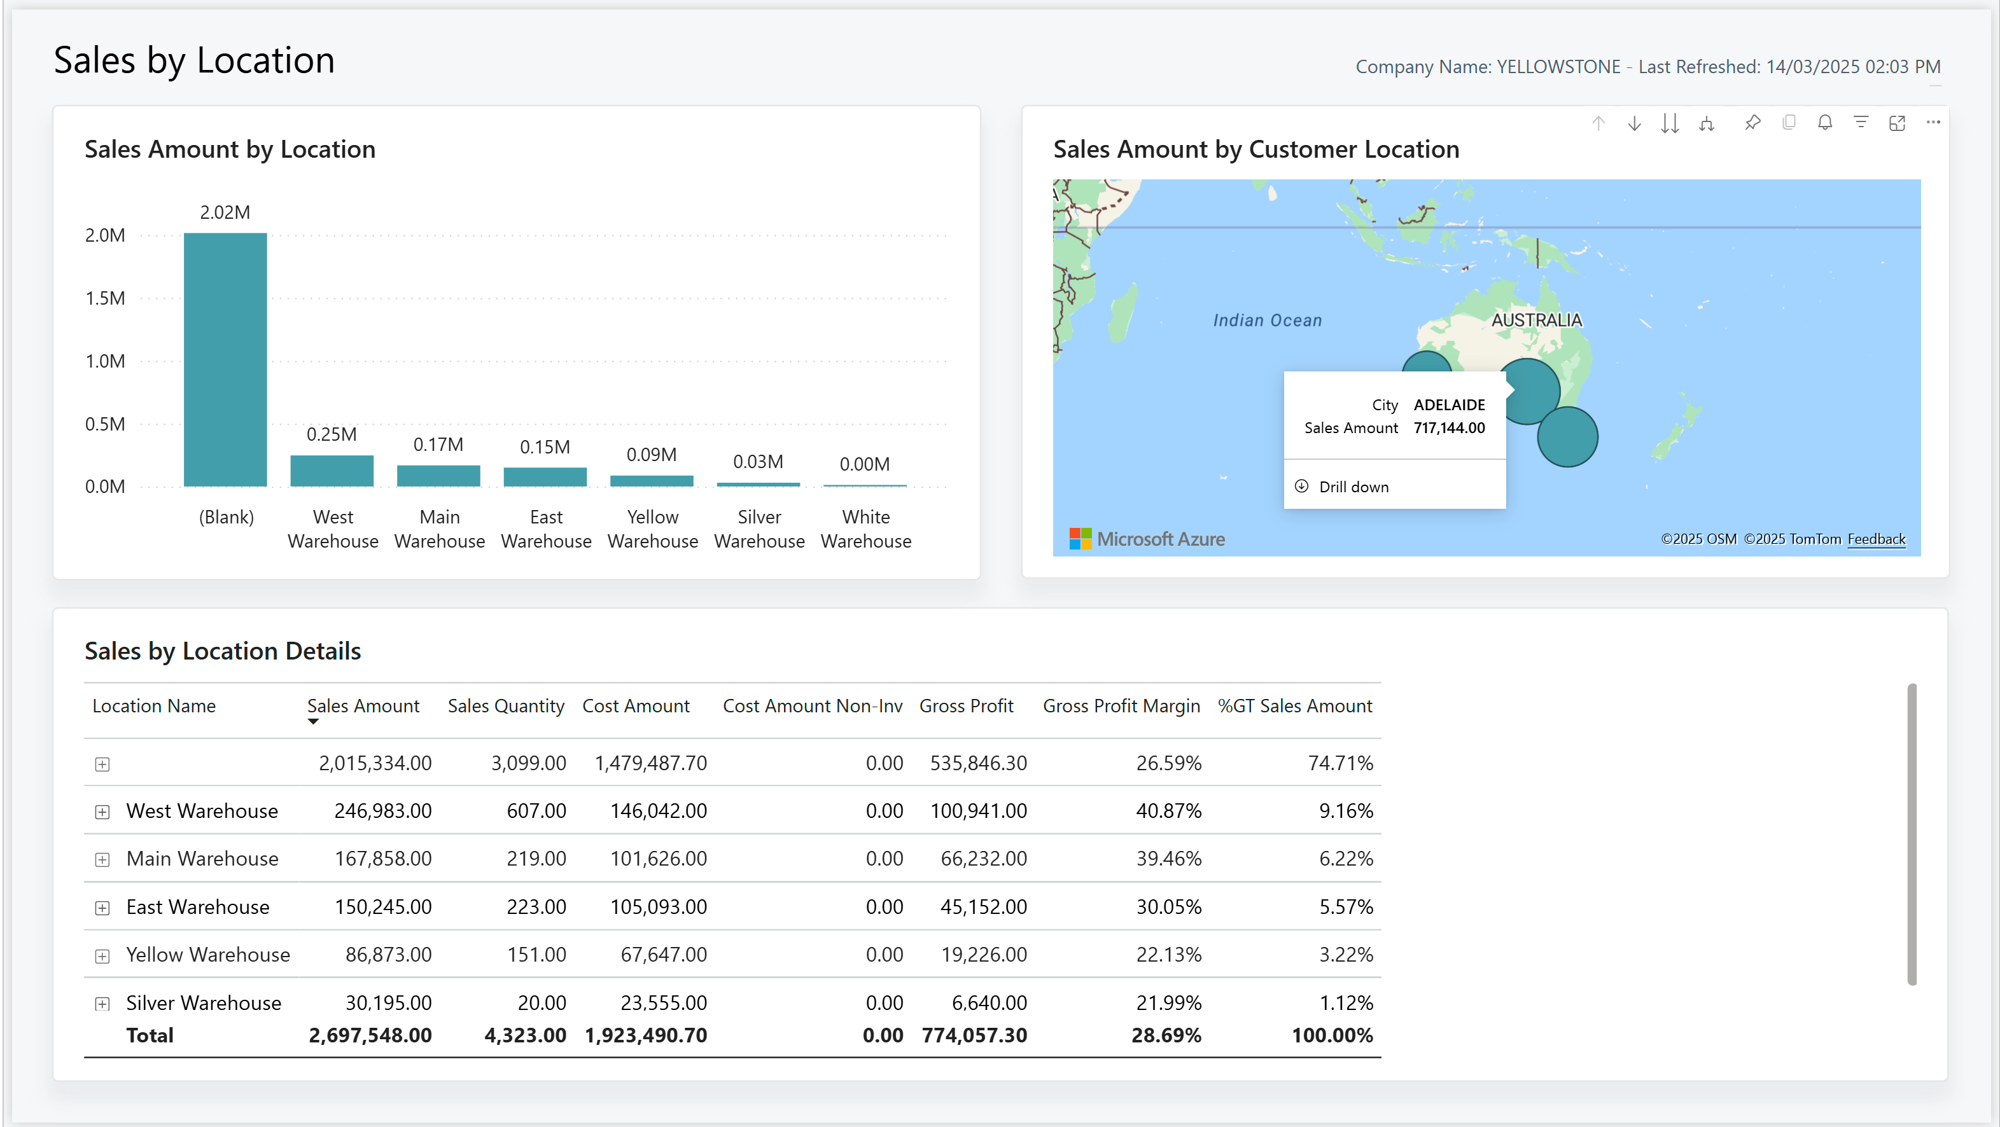
Customer demographics (location)

Slide 24
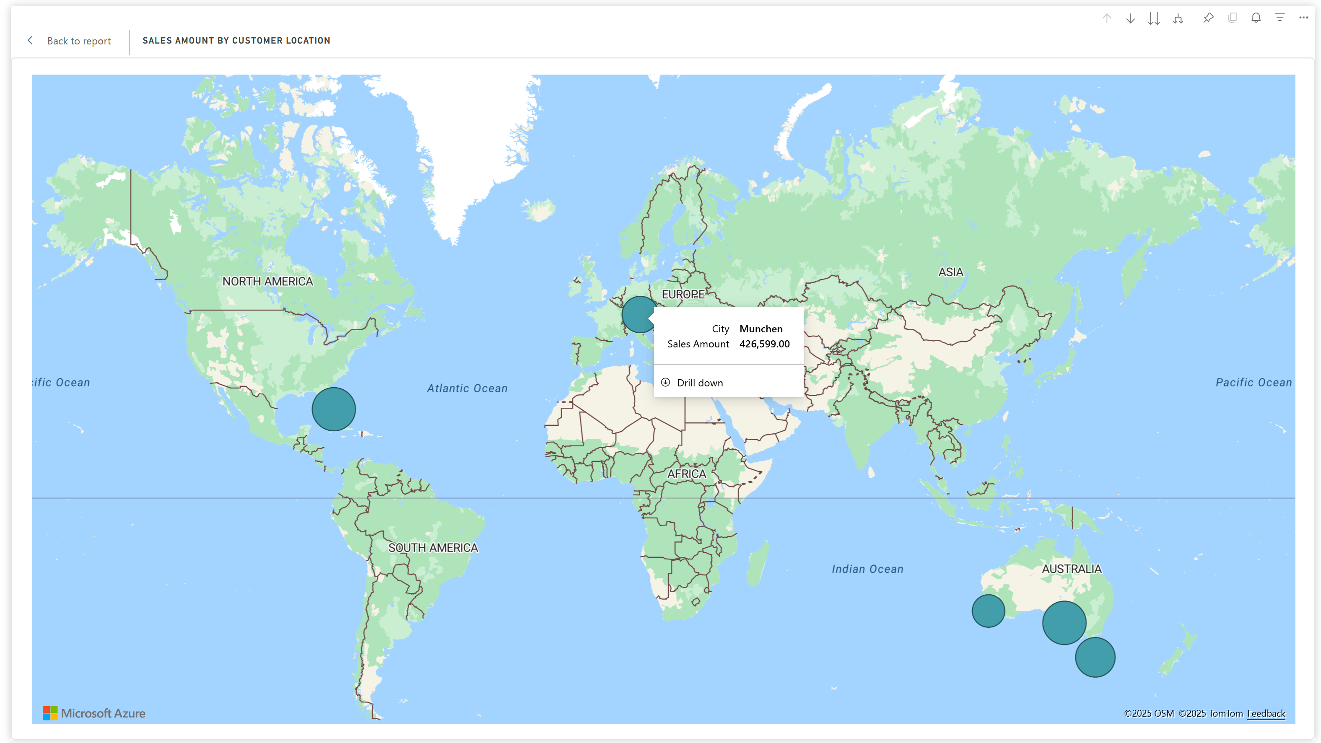
Expand the map to get your world sales map

Slide 25
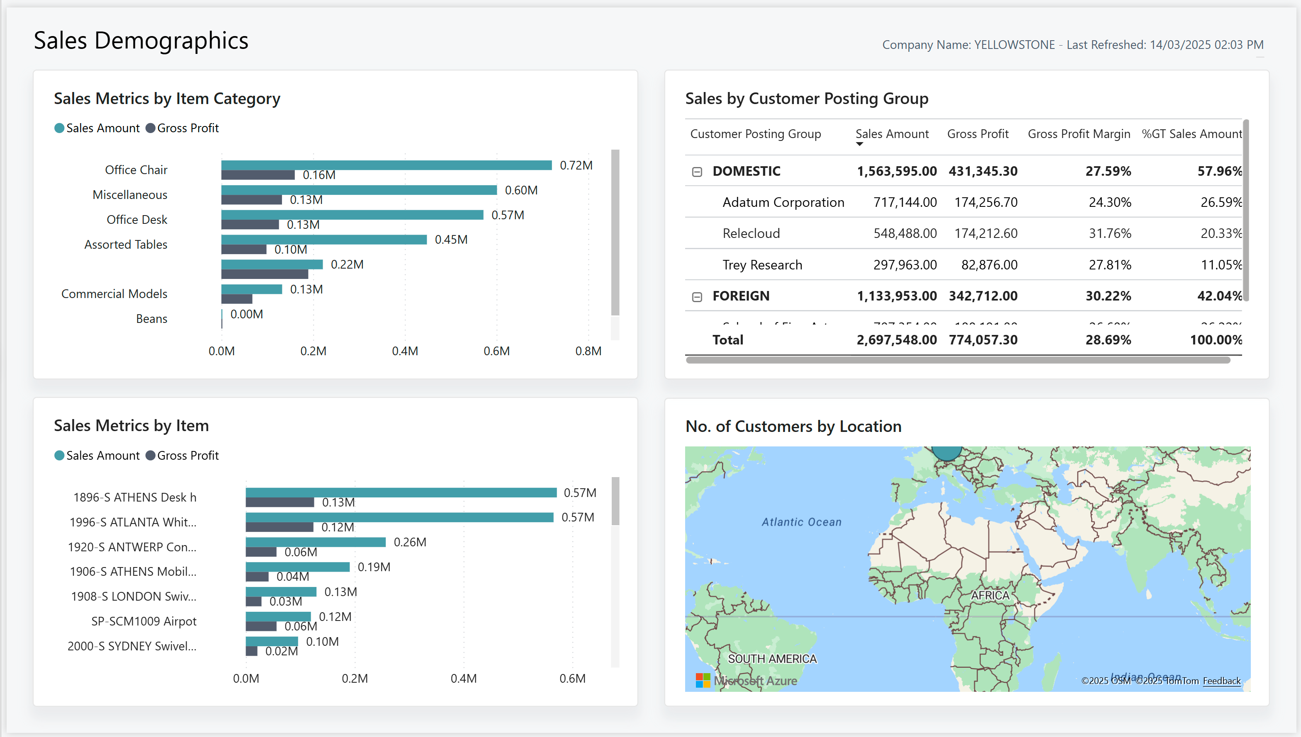
Sales demographics (by item or customer)

Slide 26
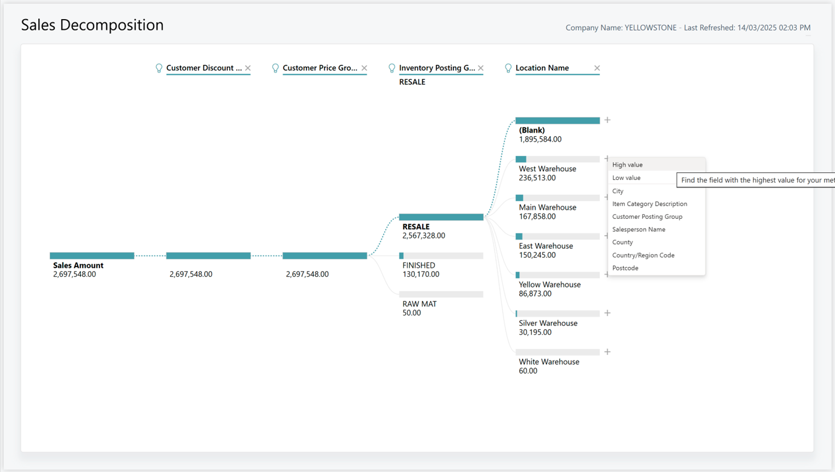
AI assisted sales analysis 1 (ad/hoc or by statistics)

Slide 27
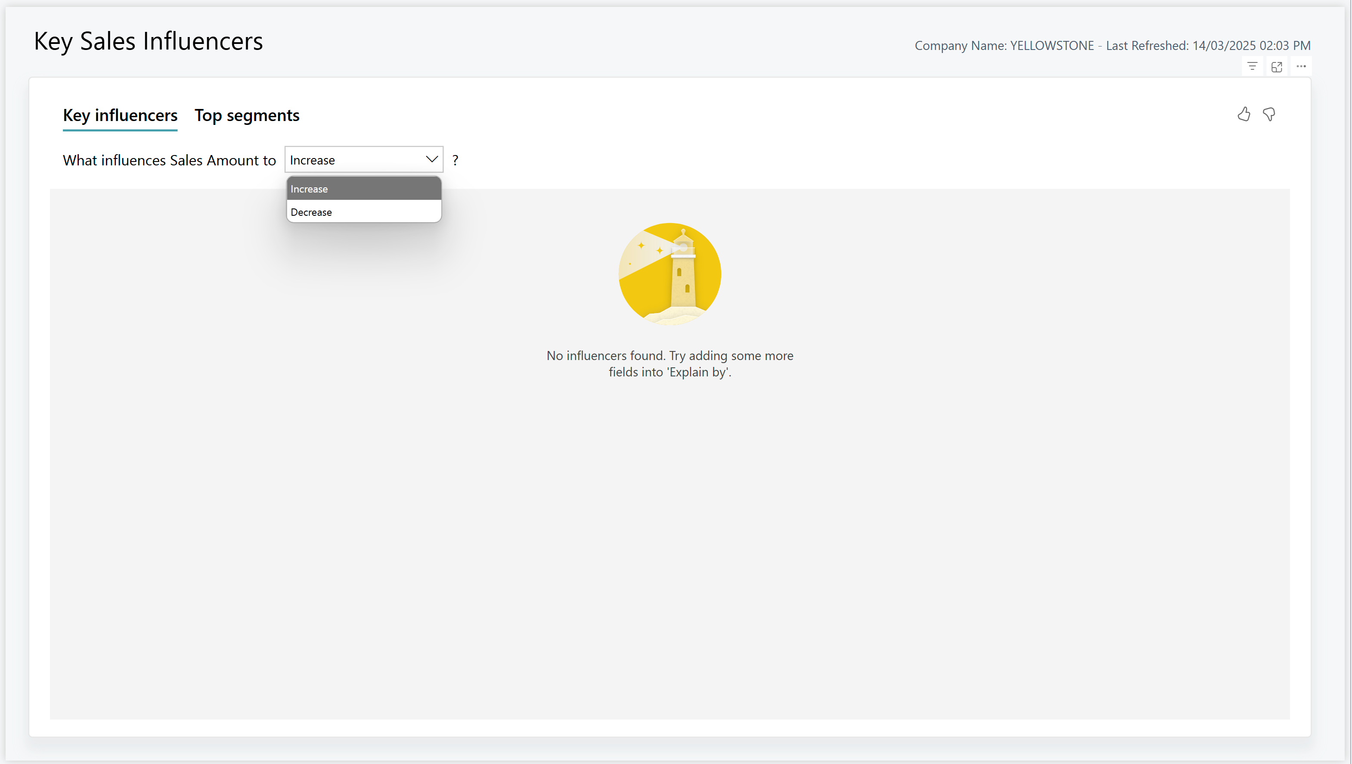
AI assisted sales analysis 2 (key drivers for high/low sales)

Slide 28
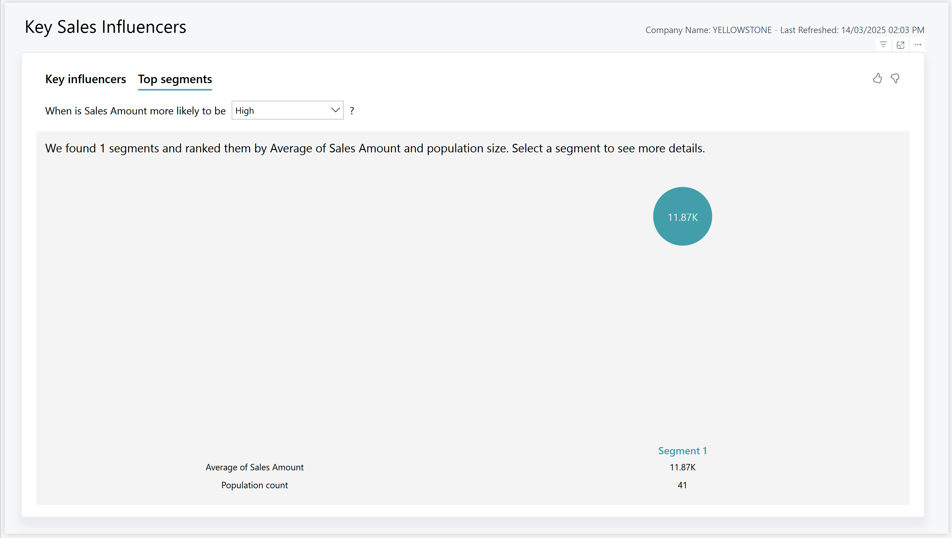
AI assisted sales analysis 3 (segmentation)

Slide 29
Hidden slide This deck is for LE25-907a LE25-907a Whats new in Power BI (for sales) There are 3 4 videos Intro PBI for sales (the AI part) Learn more

Slide 30
Enhanced Power BI app for Sales (26.1)
New reports
Updated reports
Sales Demographics
Sales Drill through
Sales Decomposition
Key Sales Influencers
Opportunity Overview
Sales Quote Overview
Sales Return Overview
Month-To-Date
Sales by Item
Sales by Customer
Sales by Sales Person
Sales by Location

Slide 31

Vision: For manufacturing analytics, in 2025
… we have completely sanitized reporting and analytics.
Everything you can analyze with existing reports has a new way: in Power BI, data analysis, or with an Excel report.
Users can track new relevant KPIs and scenarios in the updated PBI Manufacturing app.
Many existing list reports get a simple Excel layout and maybe also a Word layout to allow customers to change things as they need. Deprecate legacy RDL layouts.
Many of the existing analytical reports have been marked as deprecated. Removal set to 2026. For each report, we have specified their replacement(s).
New Manufacturing analytics section in Microsoft Learn. All existing reports have teaching tips and are documented, including deprecation and replacement options.

Slide 32
Enhanced Power BI app for Manufacturing (26.1)
Updated reports
New reports
Work Center Load
Expected Capacity Need
Finished Production Orders
Consumption Variance
Capacity Variance
Production Scrap
Deprecated (replaced by Load reports)
Current Utilization
Historical Utilization
Work Center Statistics
Machine Center Statistics
Machine Center Load
Prod. Order - List
Production Order Overview
Task List Drill through
Prod. Order Routing Gantt
Task List Drill through

Slide 33
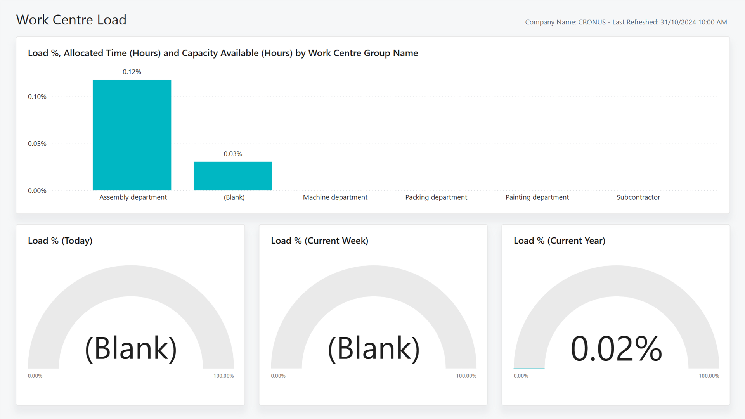
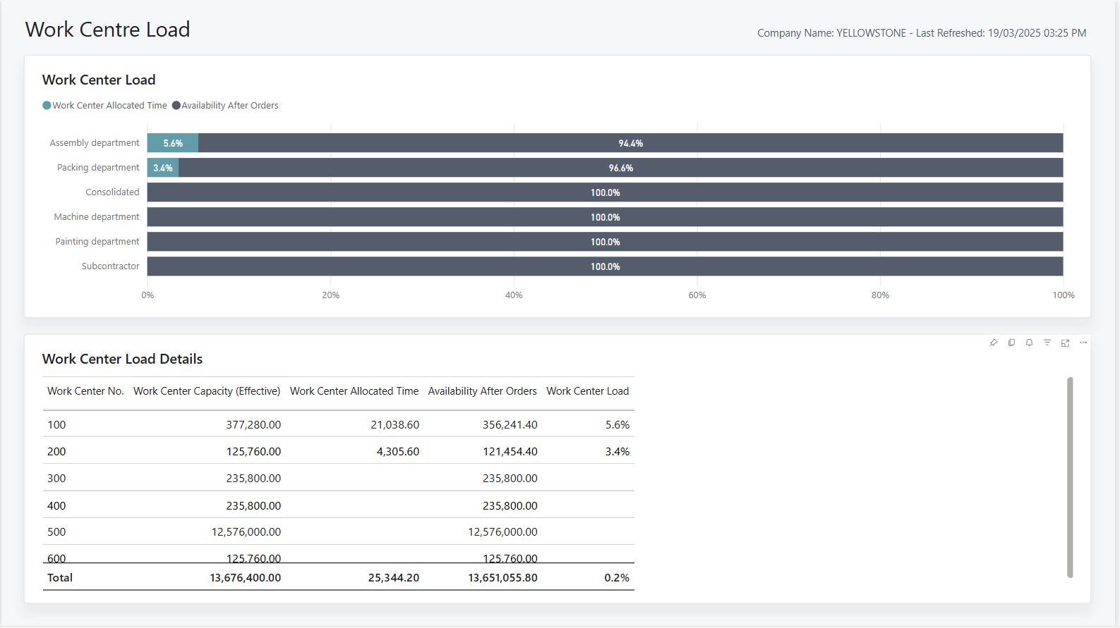
Work Centre Load
25.1
Now (26.1)

Slide 34
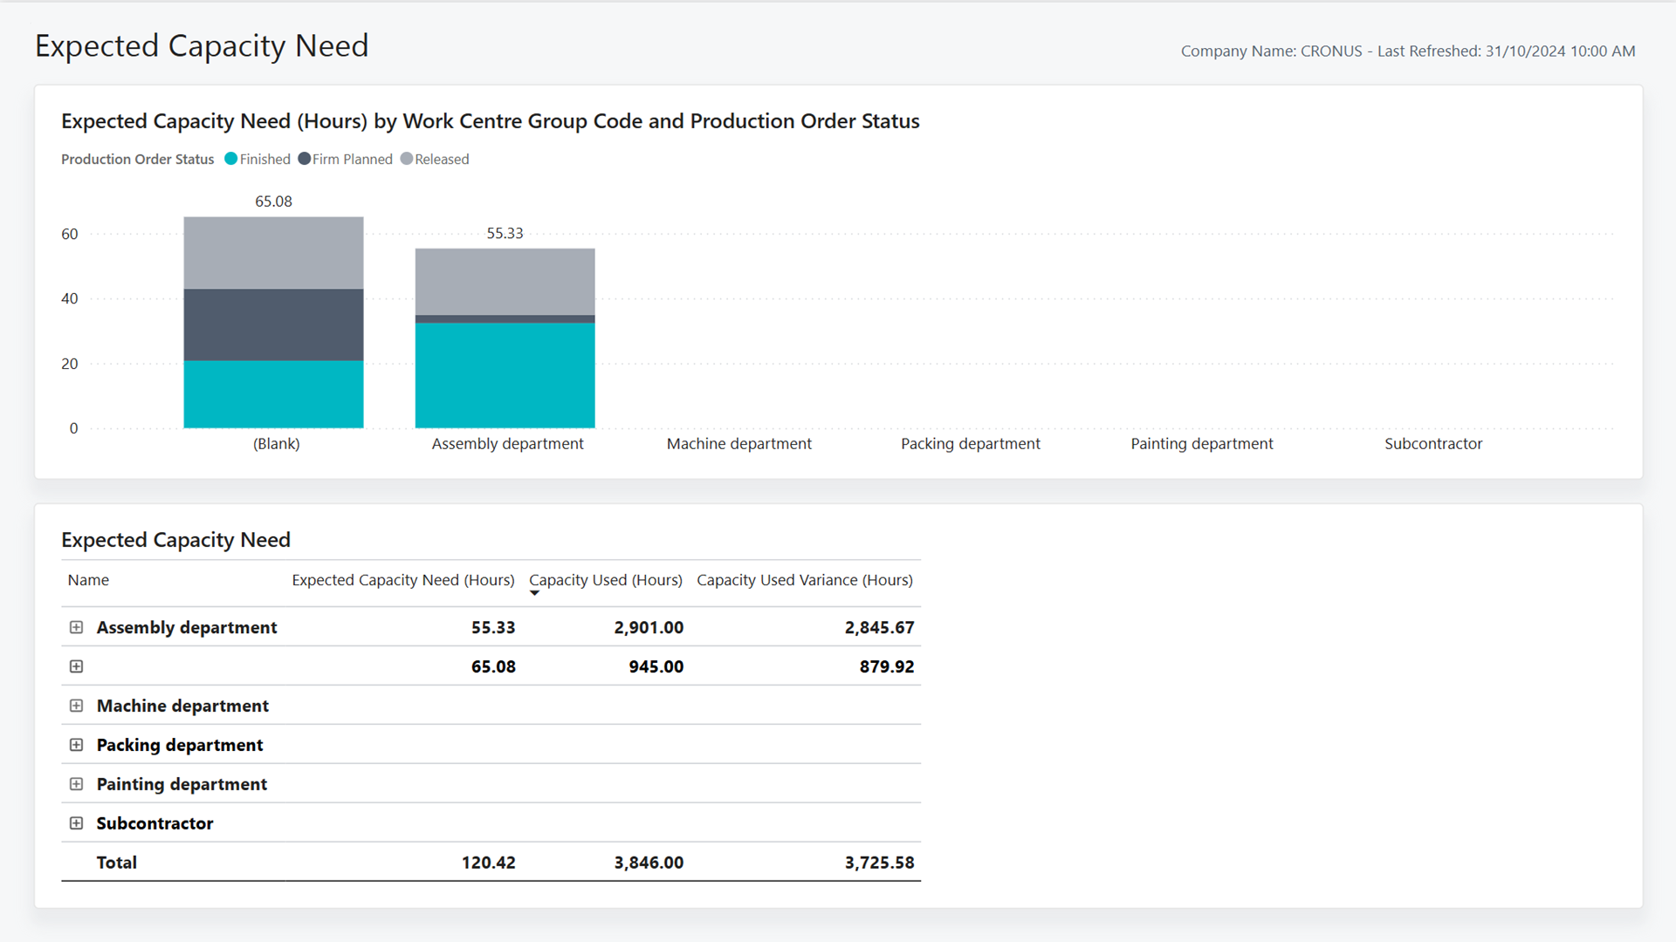
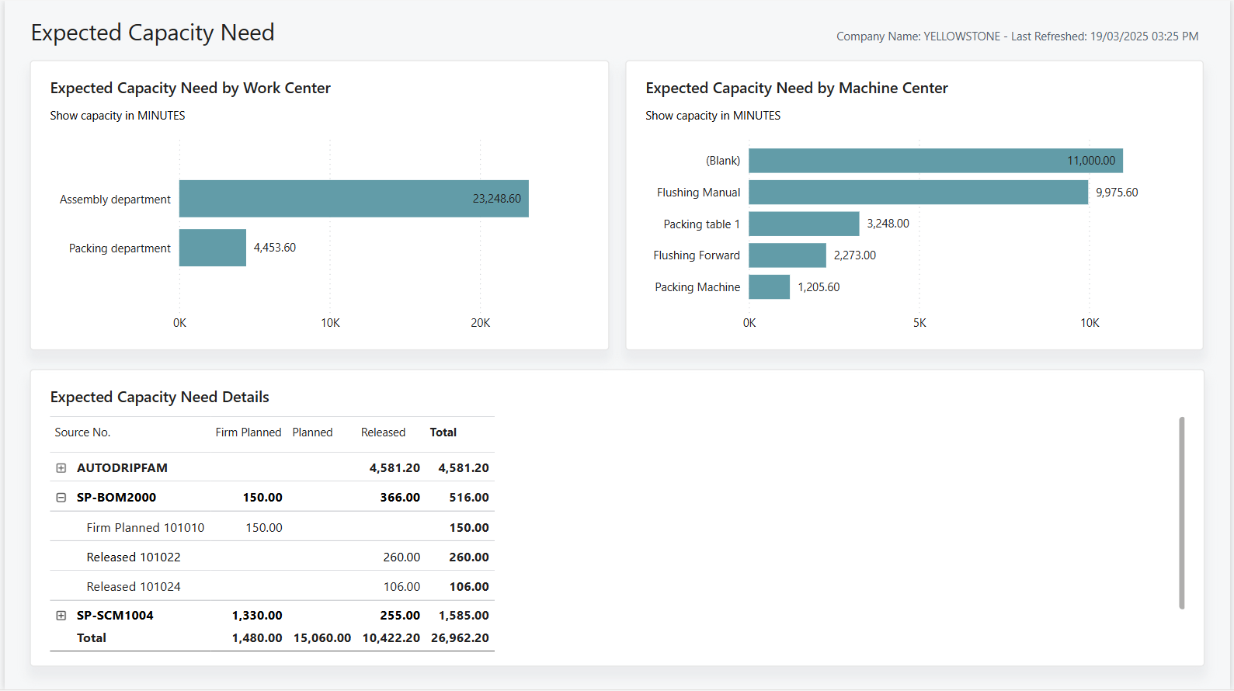
Expected Capacity Need
25.1
Now (26.1)
Notes:
Reworked to show Expected Capacity Need for both Machine Center and Work Centers. Details by Source No and Production Order No.

Slide 35
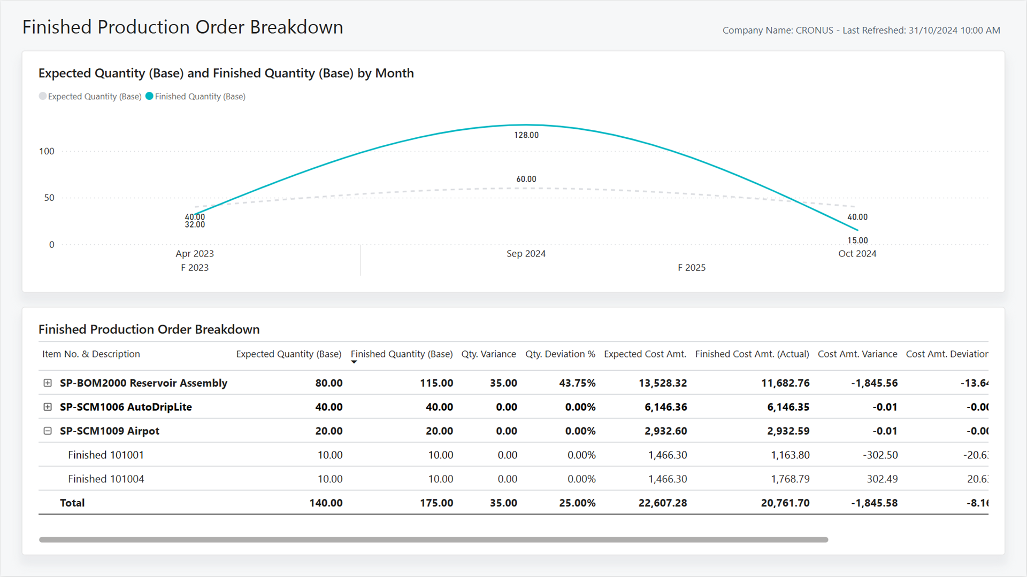
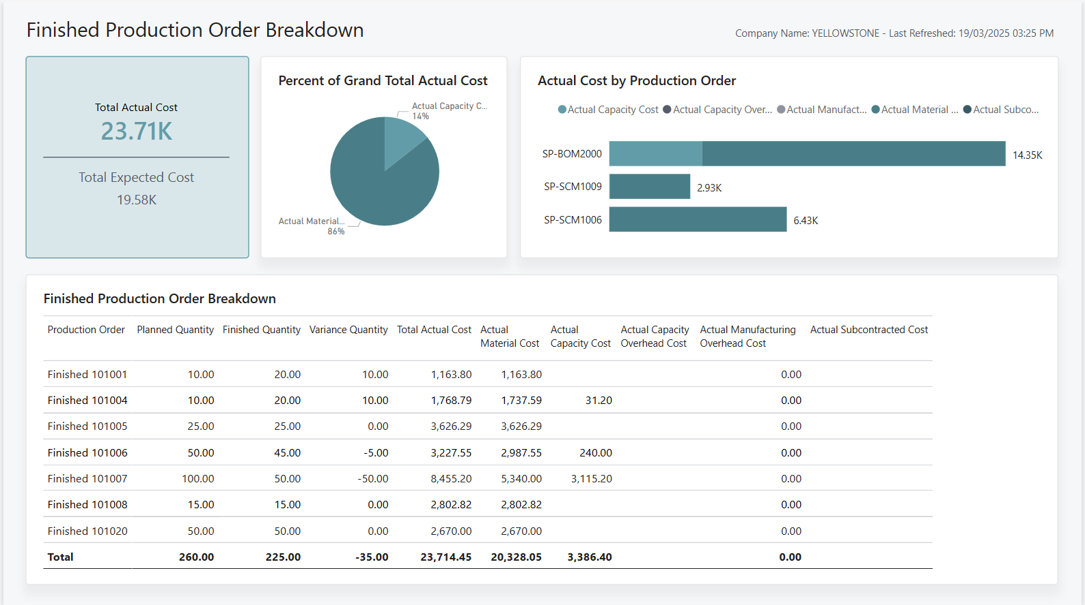
Finished Production Order Breakdown
25.1
Now
Notes:
Focused on Actual vs. Expected Costs for Finished Production orders.
Total cost broken down by cost type ( Material, Capacity, Overhead etc. )

Slide 36
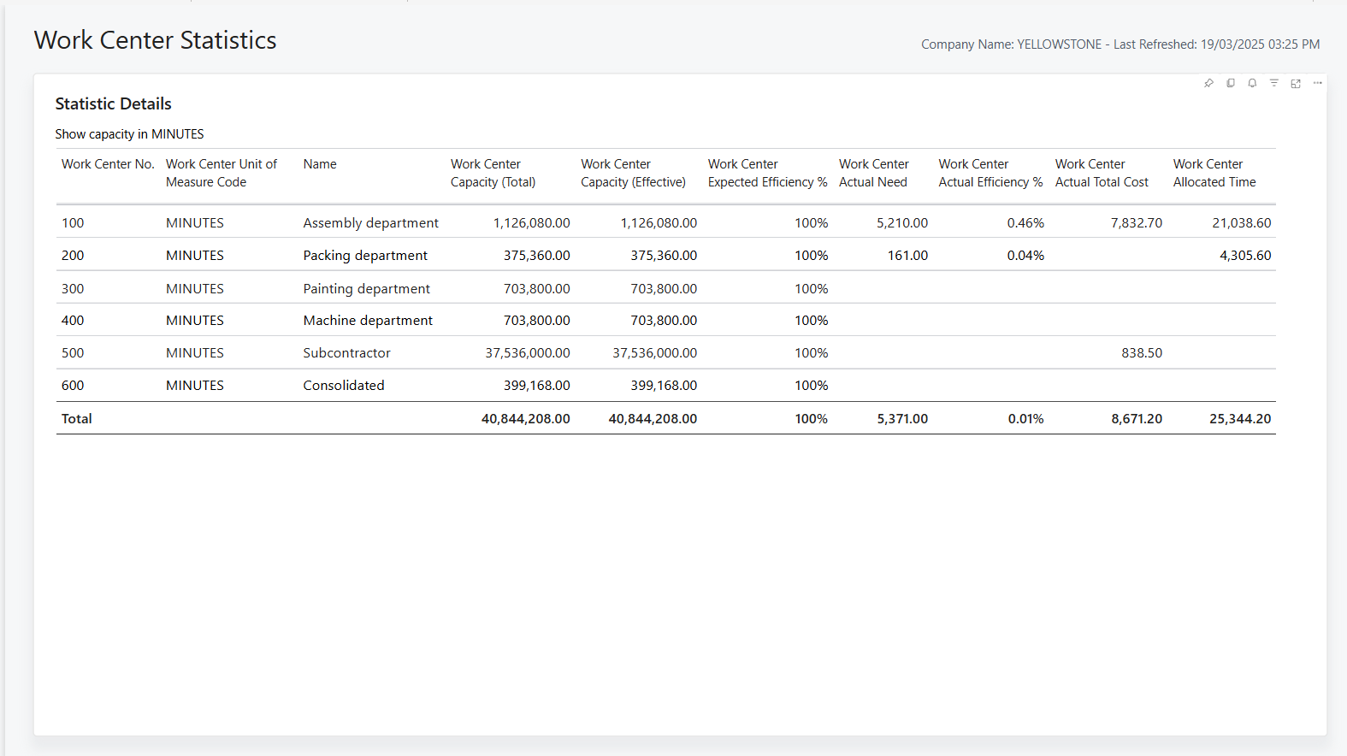

Slide 37
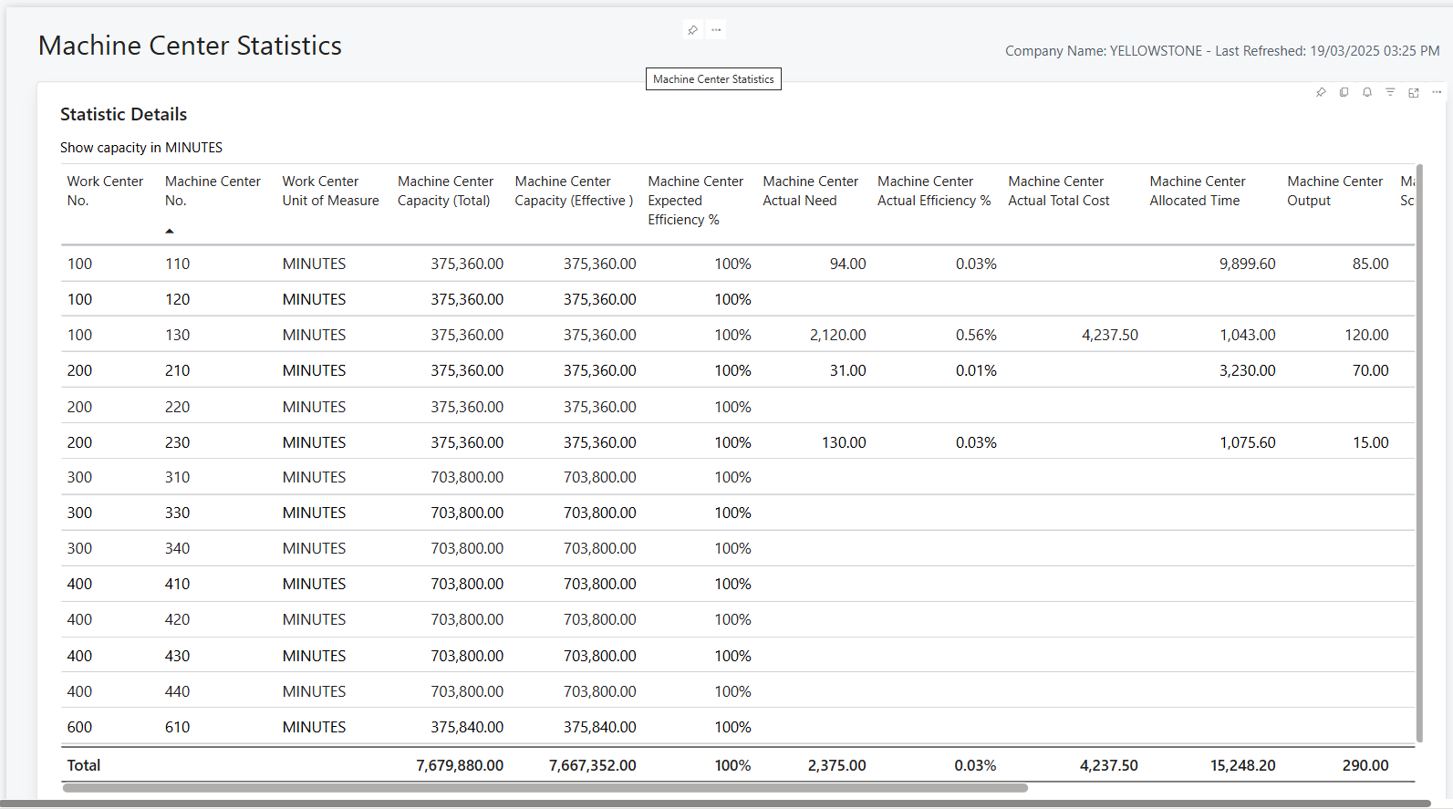
Notes:
Same as above, but with additional scrap measures

Slide 38
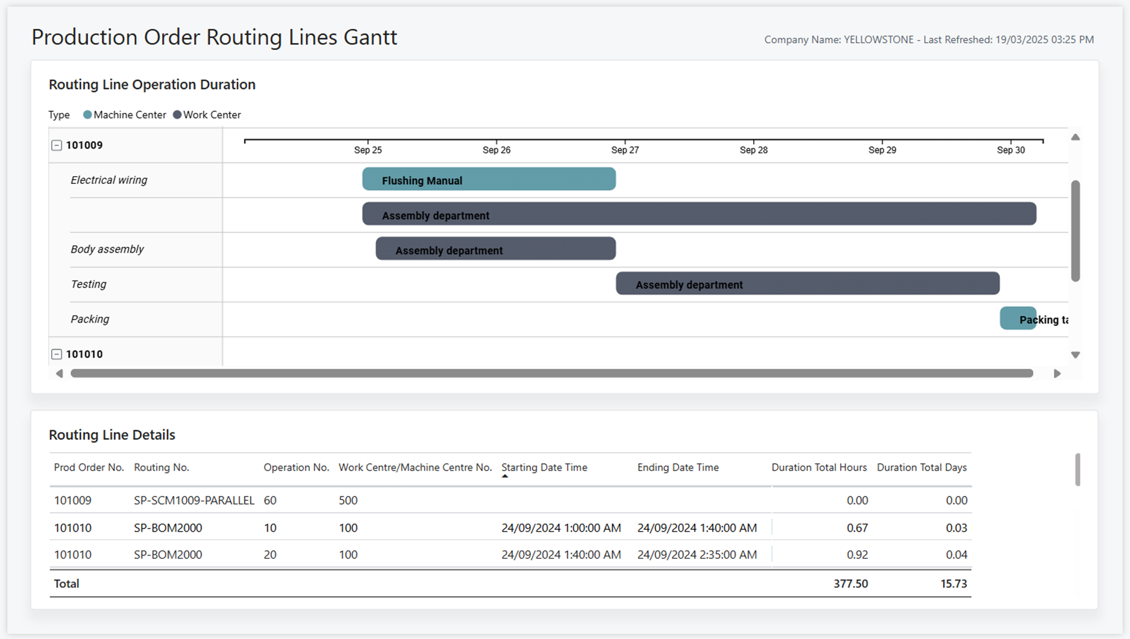

Slide 39
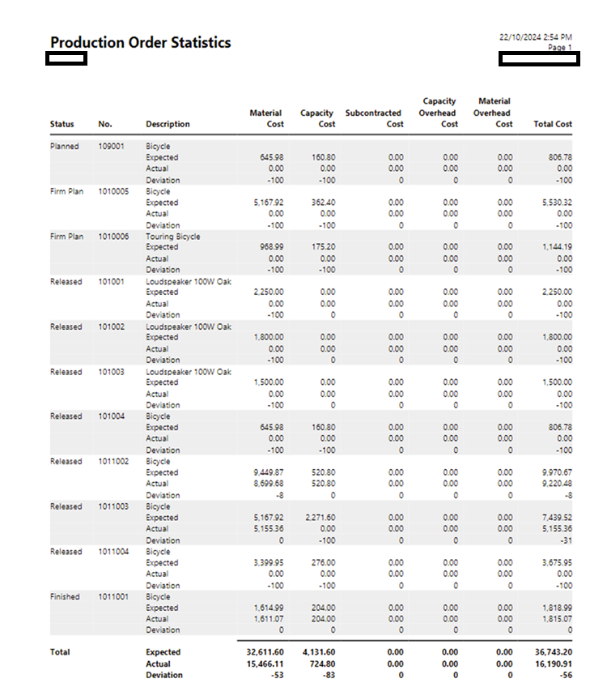
Legacy: Production Order Statistics

Slide 40
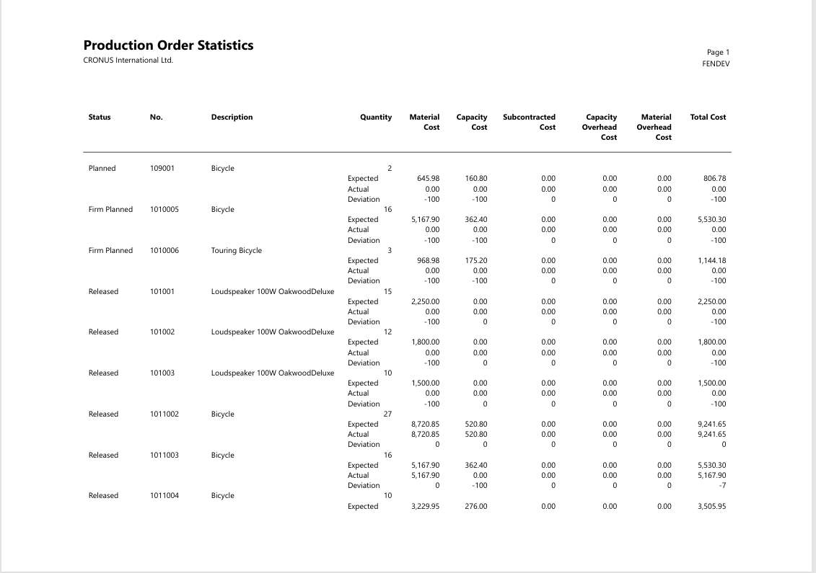
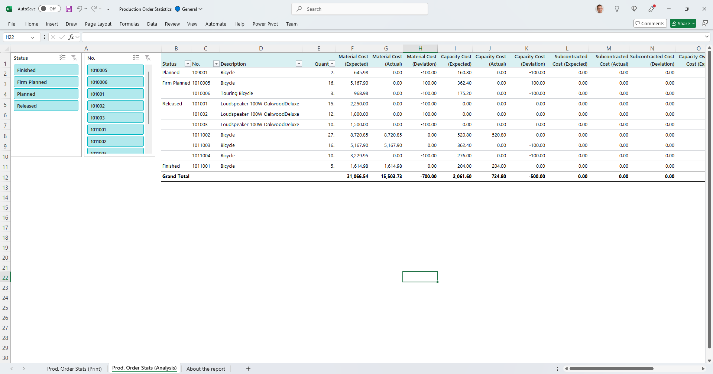
Modernized: Production Order Statistics
Keep report, deprecate RDL layout, add Word + Excel layouts
Word layout
Excel layout
Notes:
Keep report, deprecate RDL layout, add Word + Excel layouts

Slide 41
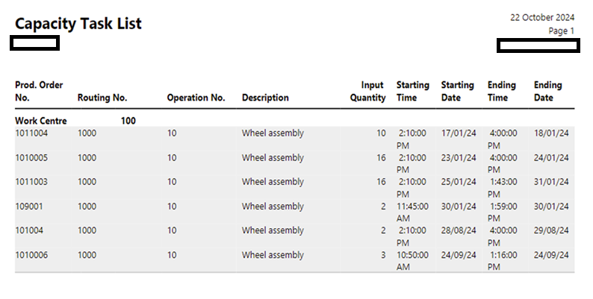
Legacy: Capacity Task List

Slide 42
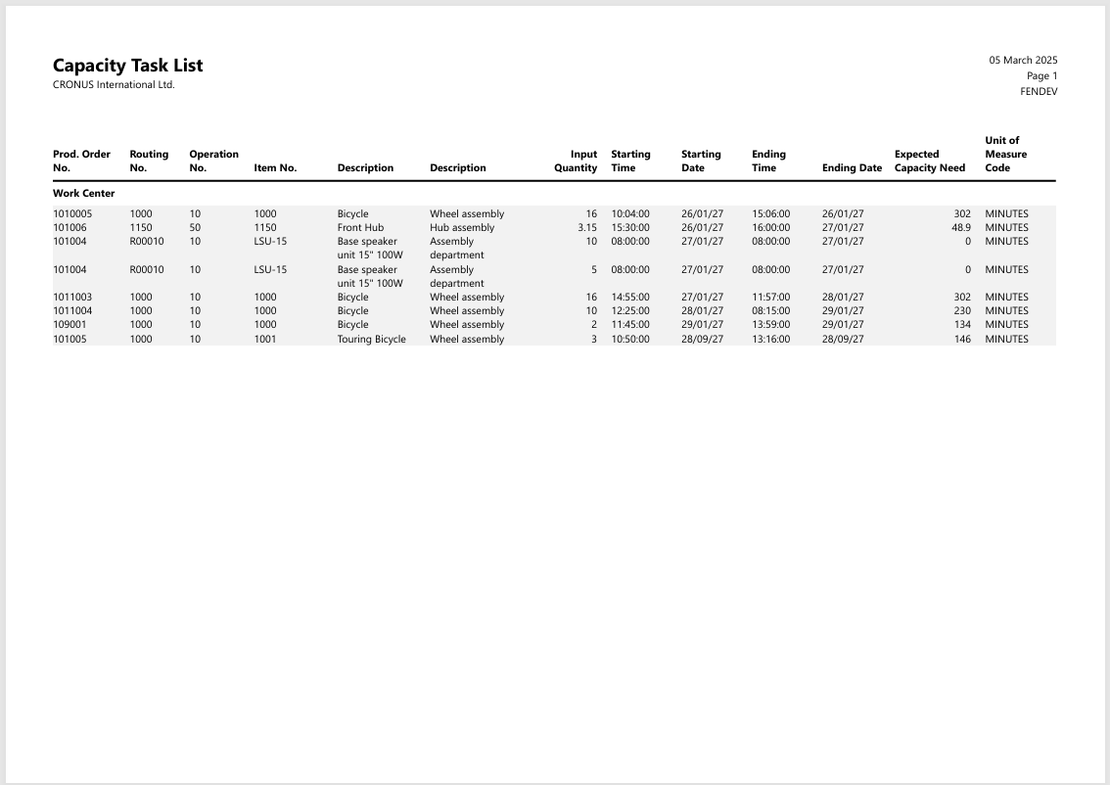
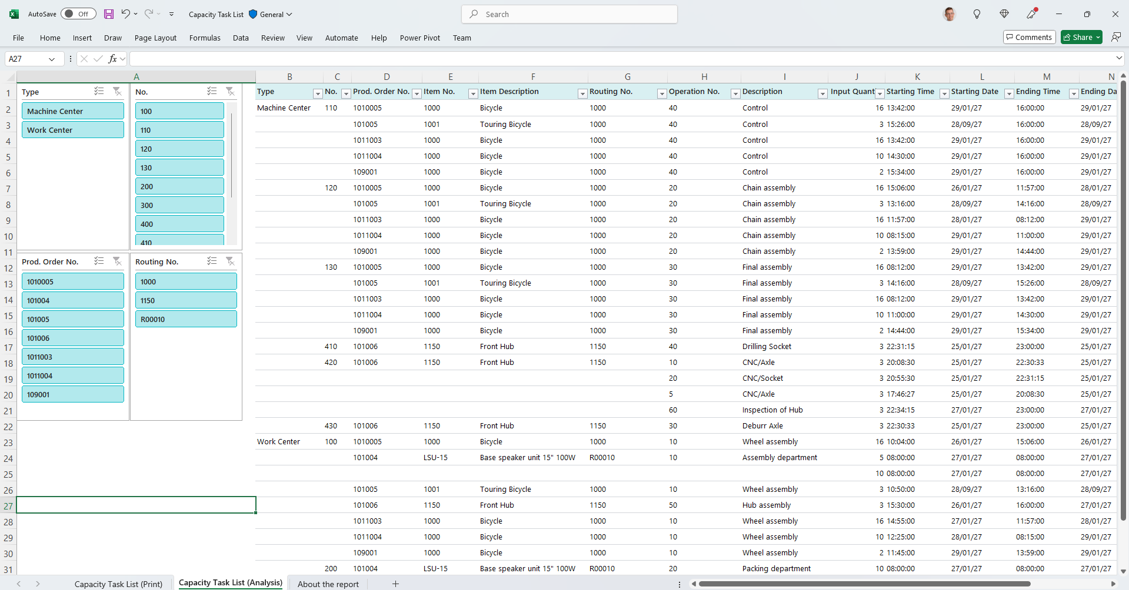
Modernized: Capacity Task List
Keep report, deprecate RDL layout, add Word + Excel layouts
Word layout
Excel layout
Notes:
Keep report, deprecate RDL layout, add Word + Excel layouts

Slide 43
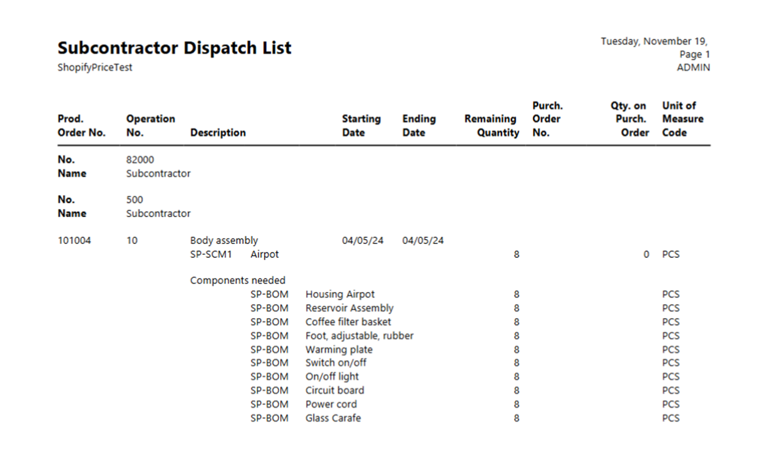
Legacy: Subcontractor - Dispatch List

Slide 44
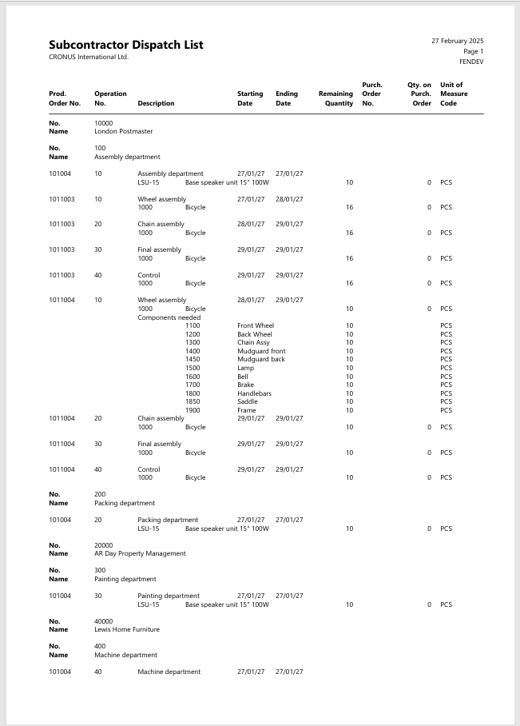
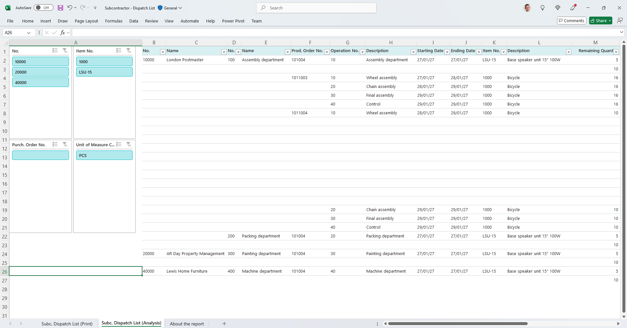
Modernized: Subcontractor - Dispatch List
Keep report, deprecate RDL layout, add Word + Excel layouts
Word layout
Excel layout
Notes:
Keep report, deprecate RDL layout, add Word + Excel layouts

Slide 45
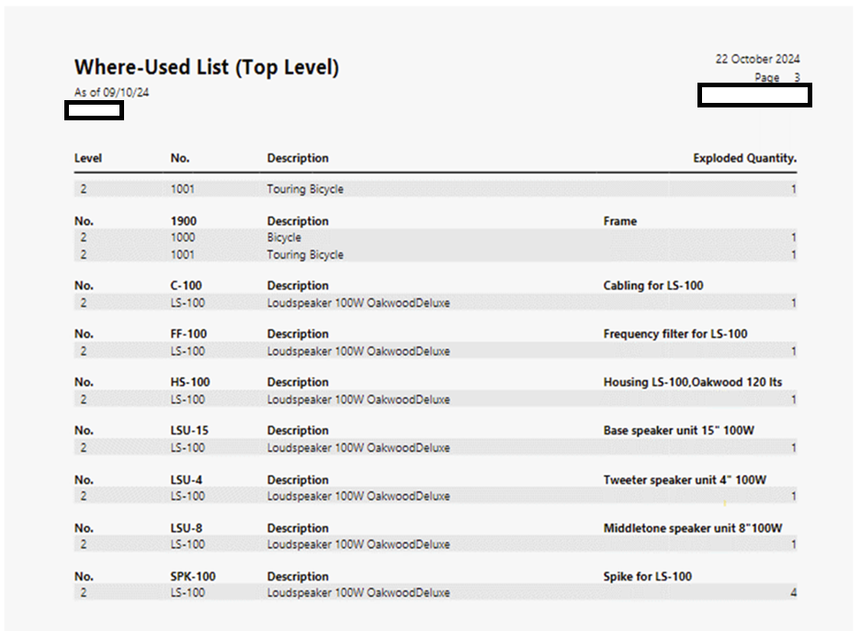
Legacy: Where-Used (Top Level)

Slide 46
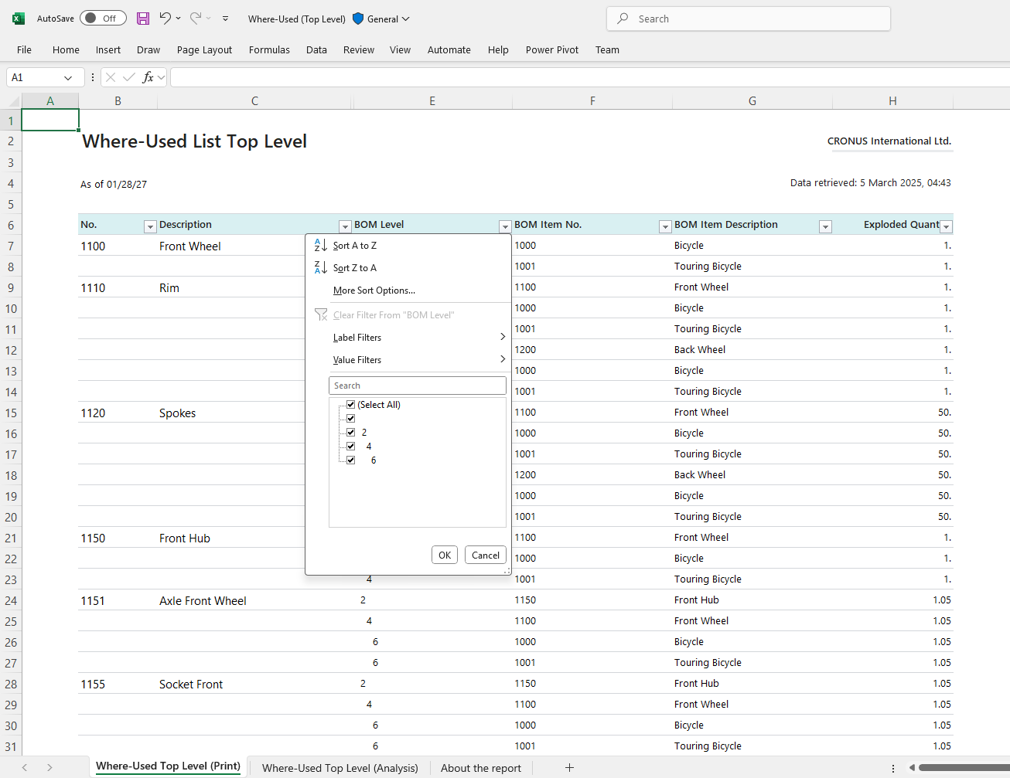
Modernized: Where-Used (Top Level)
Deprecate the RDLC layout
Add Excel layout

Slide 47
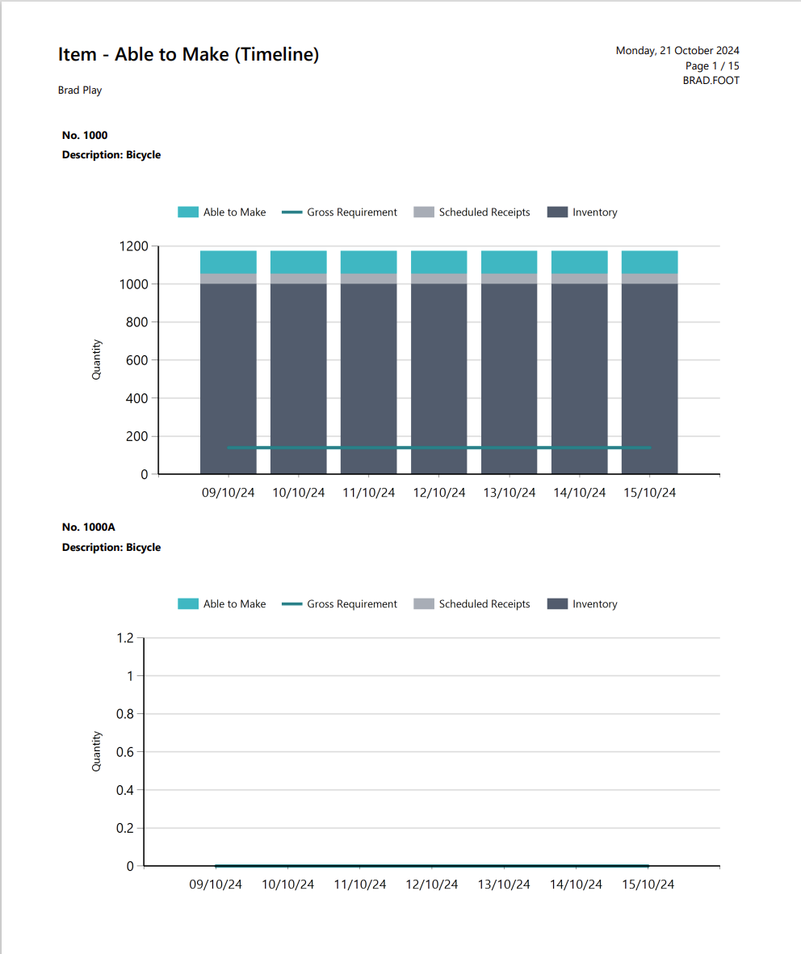
Lecacy: Item - Able to Make (Timeline)

Slide 48
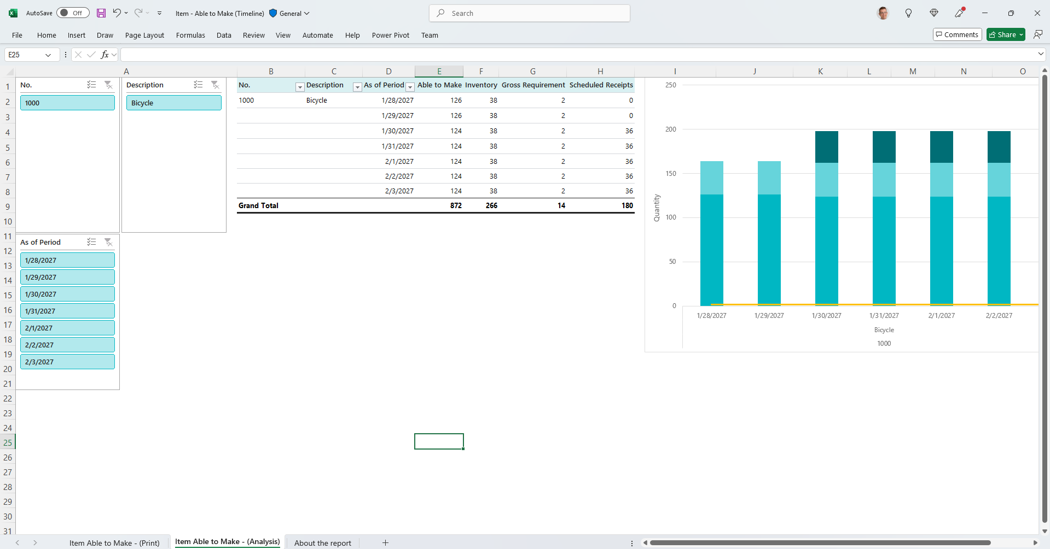
Modernized: Item - Able to Make (Timeline)
Deprecate the RDLC layout
Add Excel layout

Slide 49
Demo: Production Order – WIP 5802

Slide 50
Updated manufacturing reports (26.2)
Production Order WIP
Production Order Statistics
Capacity Task List
Subcontractor - Dispatch List
Where-Used (Top Level)
Item - Able to Make (Timeline)

Slide 51
New Manufacturing reports
26.2

Slide 52
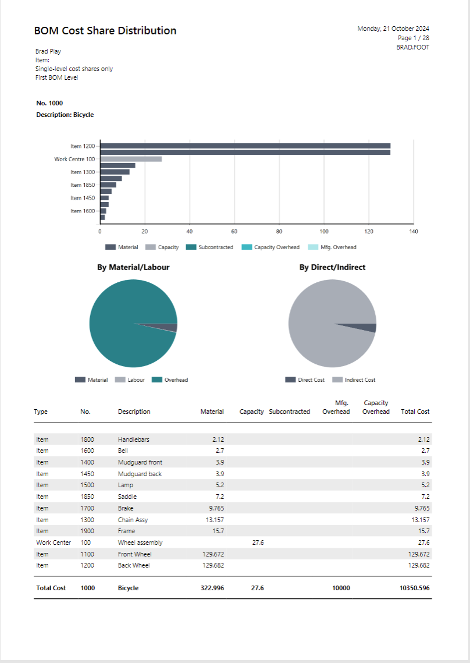
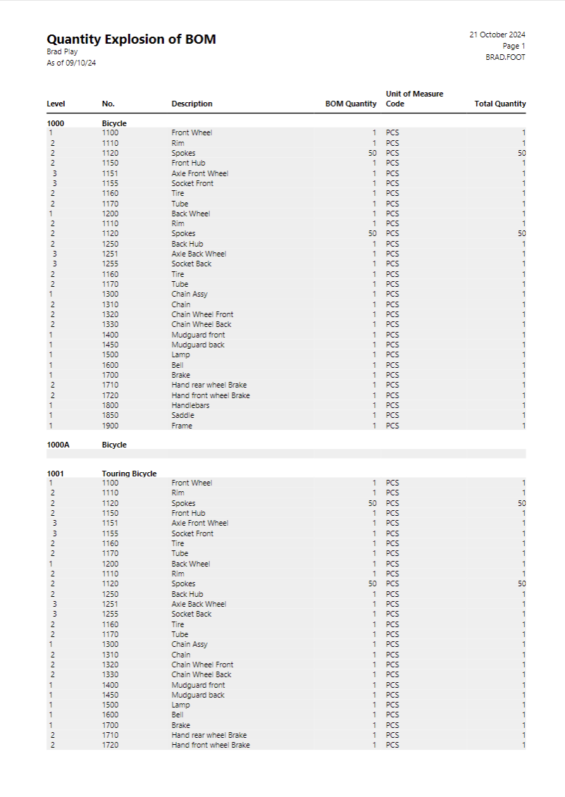
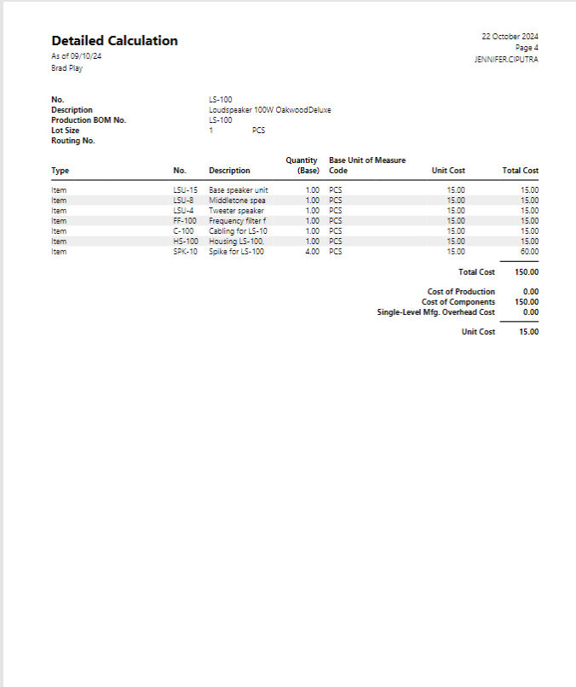
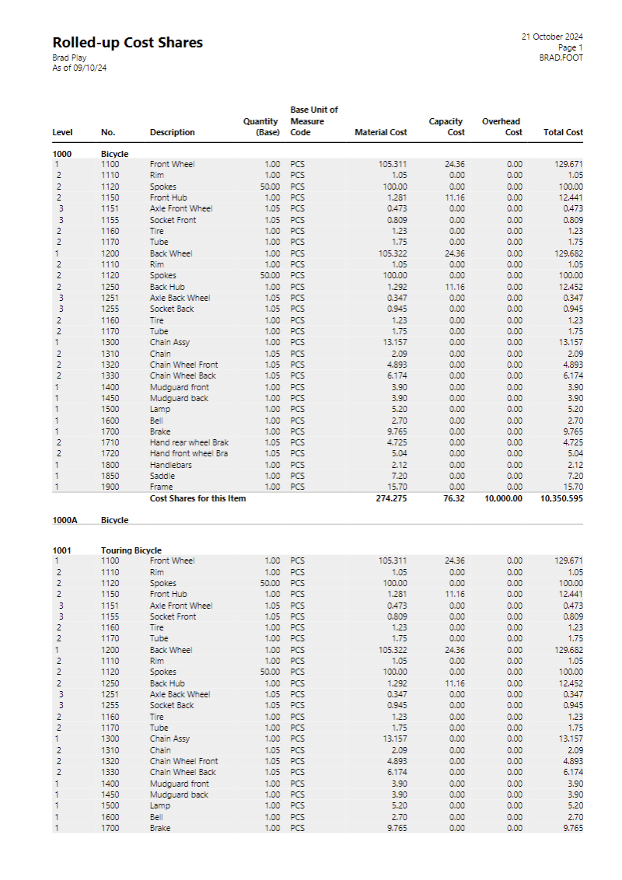
Legacy Production cost reports

Slide 53
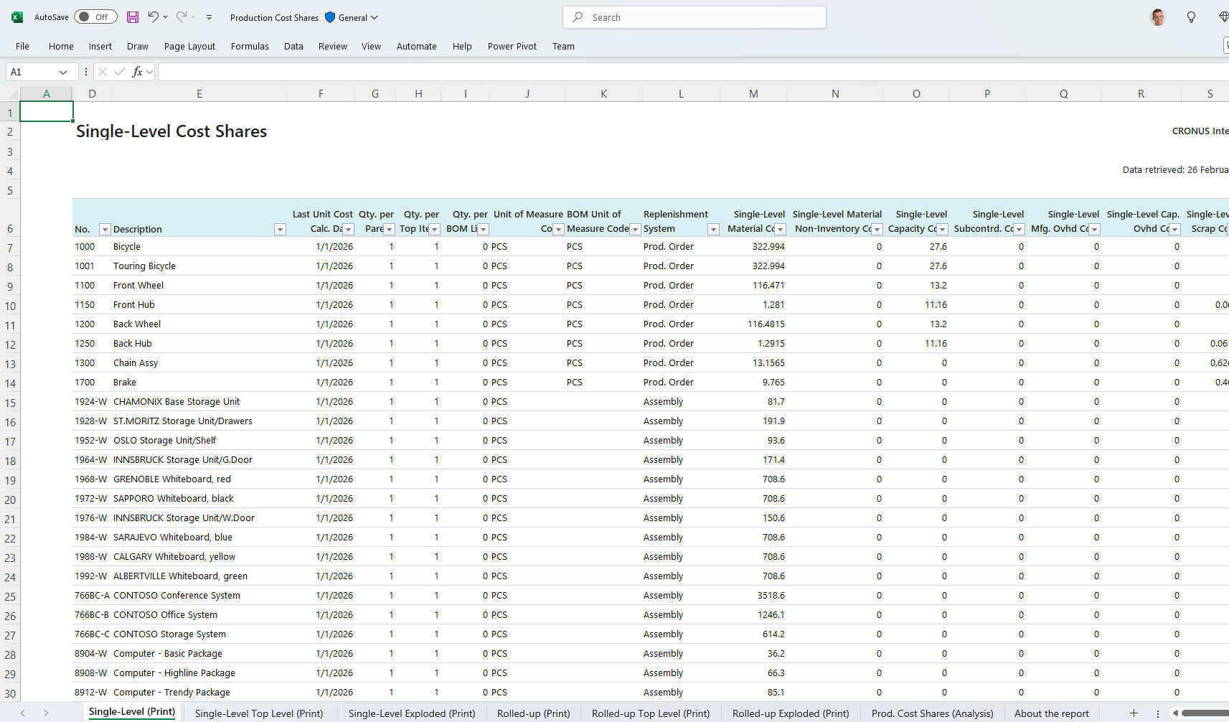
Replaced: New Production Cost Shares report
Replacing
BOM Cost Share Distribution
Cost Share Reports
Detailed Calculation reports
Quantity Explosion of BOM

Slide 54
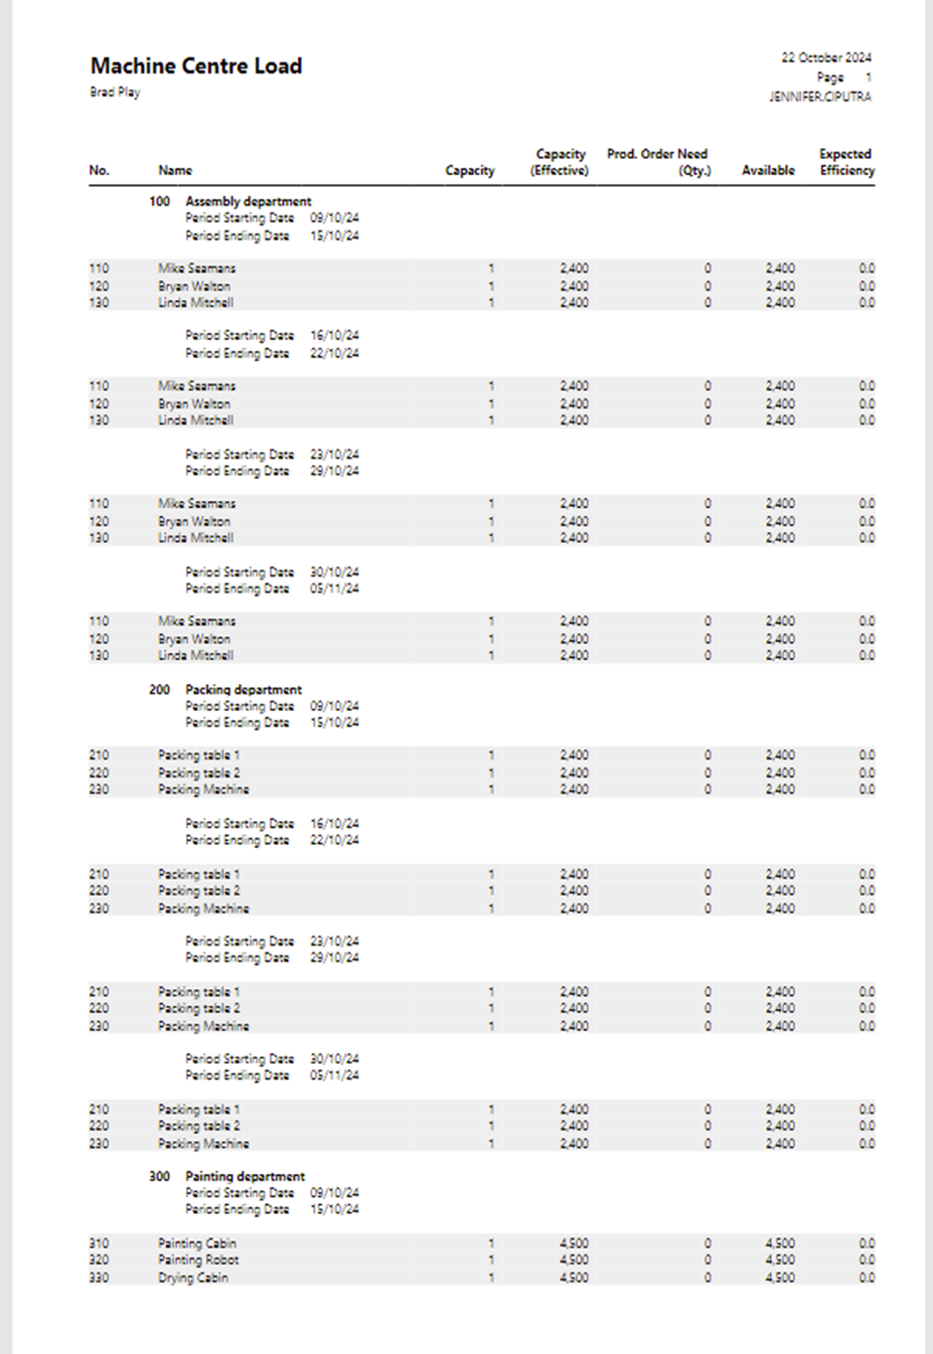
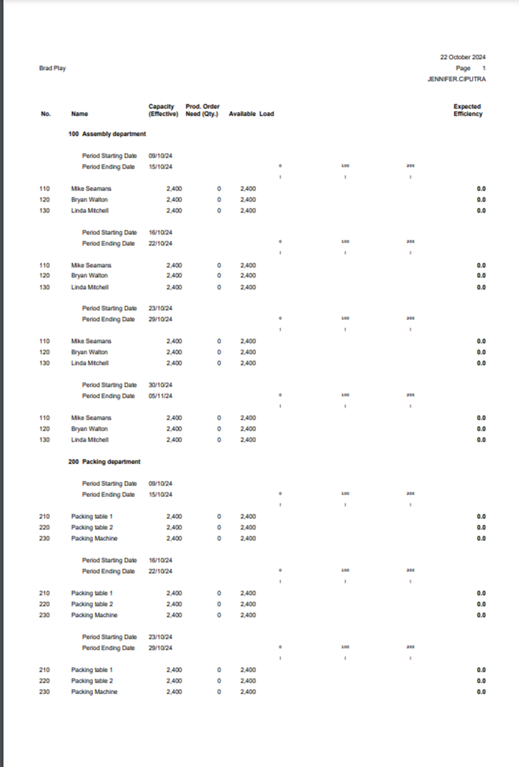
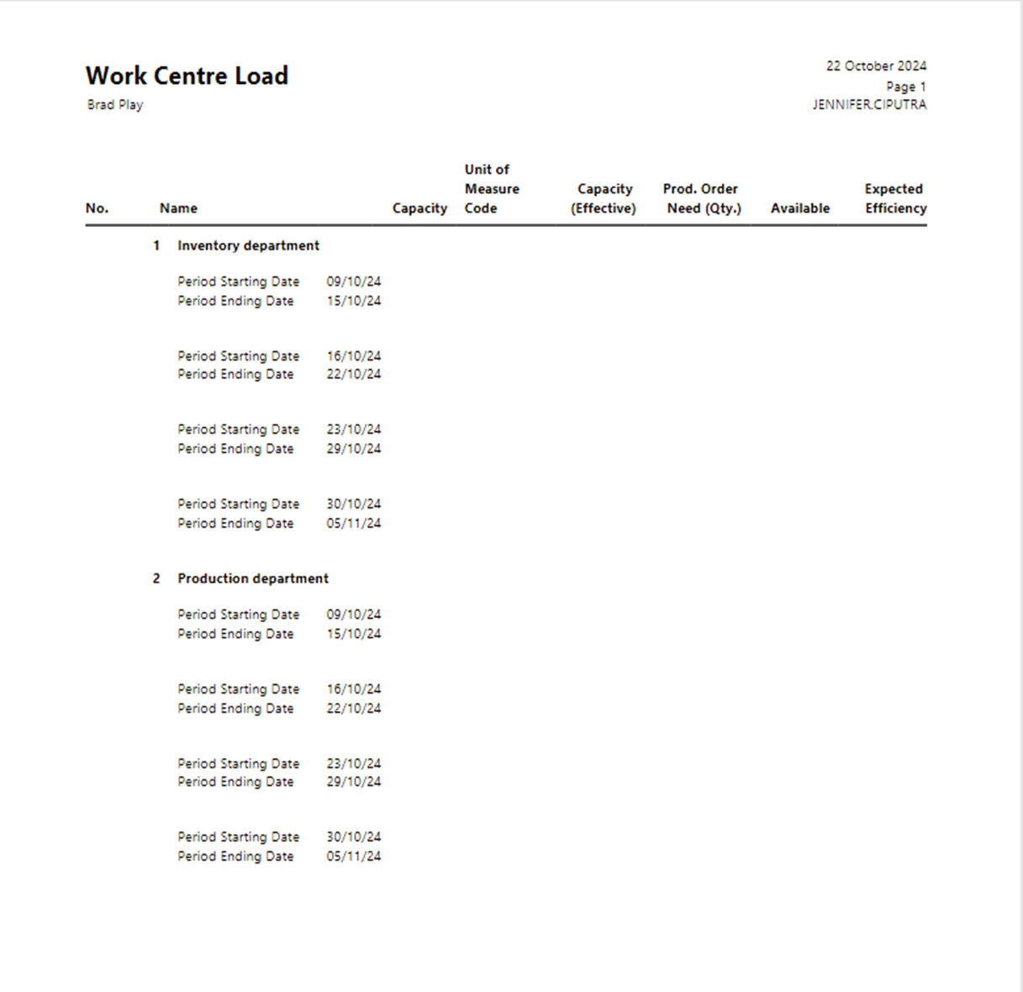
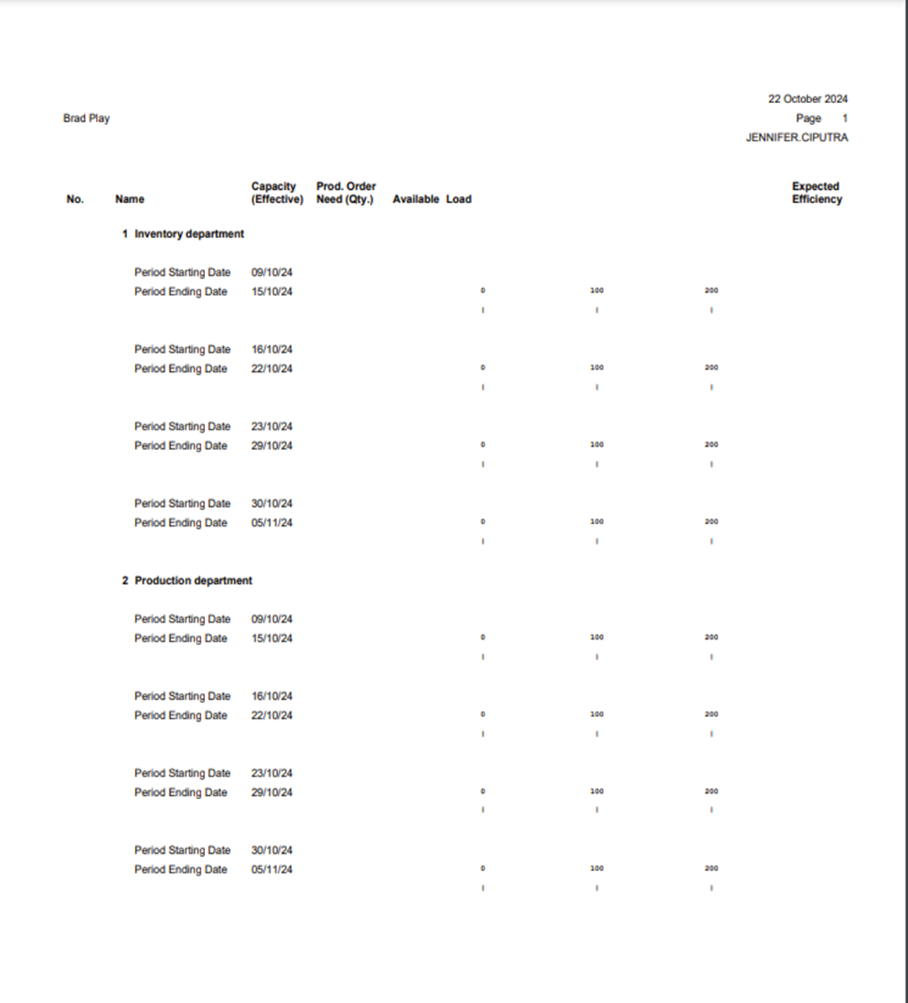
Legacy Work/Machine Center Load reports

Slide 55
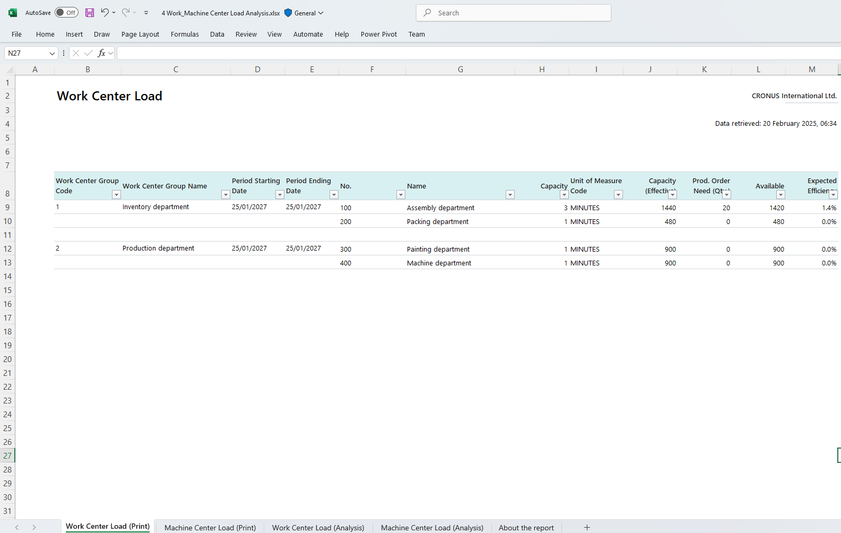
Replaced: New Work/Machine Center Load report
Replacing
Work Center Load
Machine Center Load
Work Center Load/Bar
Machine Center Load/Bar

Slide 56
New manufacturing reports (26.2)
Production Cost Shares
Work/Machine Center Load

Slide 57
Obsolete Manufacturing reports

Slide 58
Obsolete manufacturing reports (warning)
Rolled-up Cost Shares
Single-level Cost Shares
Detailed Calculation
Compare List
Work Center List
Machine Center List
Prod. Order - Calculation
Work Center Load
Machine Center Load
Work Center Load/Bar
Machine Center Load/Bar

Slide 59
Finance Excel reports now generally available
Trial balance
Trial balance/budget
Trial balance by period
Trial balance/previous year
Consolidated trial balance
Aged Accounts Receivable
Aged Accounts Payables
Notes:
Demo: Aged Accounts Receivable

Slide 60
Sales and purchasing Excel reports now generally available
Customer - Top 10 List
Vendor - Top 10 List
(Aged Accounts Receivable)
(Aged Accounts Payables)

Slide 61
Sales and purchasing data analysis (26.1)
Sales Order Performance Analysis (query)
Purchase Order Performance Analysis (query)
Notes:
Demo: Sales Order Performance Analysis

Slide 62
Fixed assets Excel reports now generally available
Fixed Asset Analysis
Fixed Asset Details
Fixed Asset Projected Value

Slide 63
Fixed assets data analysis (25.3)
Fixed Assets Ad-hoc Analysis (query)

Slide 64
Sustainability Excel reports (updated layouts)
Total Emissions
Emission by Category
Emission Per Facility

Slide 65
Legacy Excel reports have been obsoleted
Balance Sheet
Income Statement
Statement of Cash Flow
Statement of Retained Earnings
Sales Taxes Collected
Customer Statements
Aged Accounts Payable
Aged Accounts Receivable

Slide 66
Reports that have been obsoleted
Finance reports
Aged Accounts Receivables (Legacy)
Aged Accounts Payable (legacy)
Trial Balance (legacy)
Trial Balance/Budget (legacy)
Fixed Assets reports
Fixed Asset Analysis (legacy)
Fixed Asset Details (legacy)
Fixed Asset Projected Value (legacy)
Sales reports
Customer - Top 10 List (legacy)
Purchasing reports
Vendor - List (legacy)
Vendor - Summary Aging (legacy)
Manufacturing reports
See other video

Slide 67
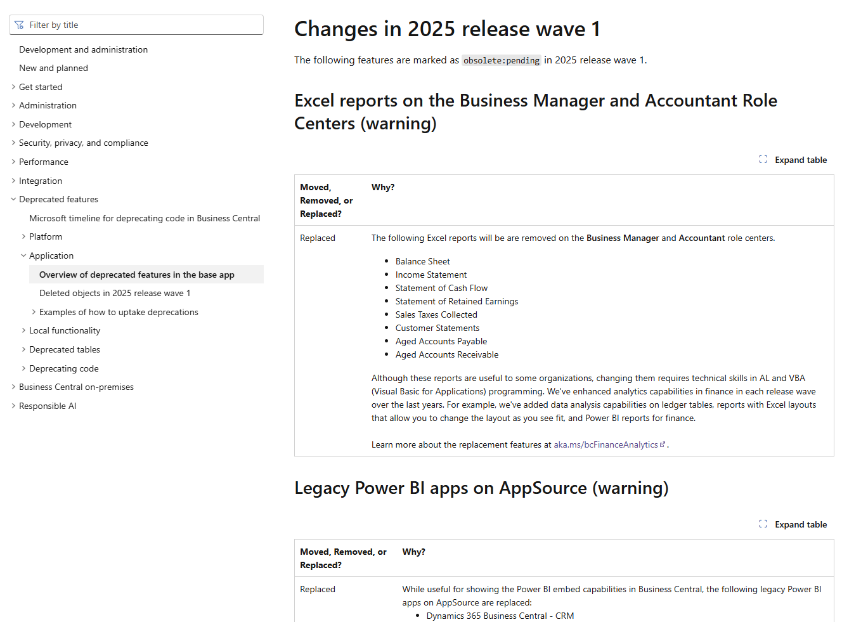
Obsoleted features and reports
Find them in our documentation

Slide 68
Bonus: Inventory data analysis (26.1)
Inventory by Location Analysis (query)

Slide 69

Bonus: Project data analysis (26.1)
Project Planning Analysis (query)

Slide 70
Data analysis new features

Slide 71

Flashback 2023RW2 List page analysis
Extract insights from your data directly in Business Central with no need to involve developers​
Great success!
Challenge: Complex cross-entity analysis
Notes:
Back in 2023 release wave 2 we launched the ability to analyse data on list pages
With this you could quickly extract insights from your data directly in Business Central with no need to involve developers.​
​
For instance, you could ​
Pick columns, reorder them
Set additional data filters​
Group and pivot​
Save your analysis for repetitive use.
CLICK: This has been a great success, including the later added Copilot NL Analysis Assist ability
CLICK: But a challenge has been analyzing more complex cross-entity data relationships – which still has required developers creating queries
We are super excited that we have now empowered users even more, addressing exactly this!
Blanca, can you tell us more?

Slide 72

Add fields from related tables in Analysis Mode
Coming in 2025 release wave 1 (26.2)
Users can add additional fields from related pages (tables) in analysis mode to build and analyze views across related data sources.
Notes:
Builds on the already existing Analysis View capability, and allows users to include additional related data sources without having to write code.
Self-service on creating complex datasets and analyzing them
Planned to come 26.2, could still change (i.e., when done)

Slide 73
Demo
Add fields from the Customer Card to and analysis on Customer Ledger Entries.
Showcase how to do an Accounts Receivable by customer location report.

Slide 74
Recap: Adding fields from related tables
Adding fields from related tables
Like regular columns
Get started by adding related columns from the Analysis View tab menu or the column menu.
The suggested related tables are those that have a table relation with the source table of the current page in AL.
We only suggest the tables that are available (not obsoleted, not temporary, not internal…) and where the user has permissions to read the data.
When joining with other tables, we perform a left outer join on the data.
It is possible to join the same table twice through different table relationships.
Hide/show
Reorder
Freeze left/right
Set filters
Group and pivot
Export to excel
Except...
Copilot analysis assist is not supported on related columns (yet)
Calculated columns are not supported

Slide 75




Queries added in 25.3 and 26.1

Slide 76
Learn more…

Slide 77

aka.ms/bcAnalytics (for users)
Notes:
This is the general analytics story end-to-end

Slide 78

Analytics per functional area (finance, sales, purchase, inventory, …)
Notes:
This is the analytics story end-to-end for each functional area

Slide 79
Analytics aka links per functional area
aka.ms/bcFinanceAnalytics
aka.ms/bcSalesAnalytics
aka.ms/bcPurchasingAnalytics
aka.ms/bcFixedAssetsAnalytics
aka.ms/bcProjectAnalytics
aka.ms/bcInventoryAnalytics
aka.ms/bcManufacturingAnalytics

Slide 80

Example: Financial Analytics (aka.ms/bcFinanceAnalytics)
Notes:
This is the analytics story end-to-end for each functional area

Slide 81

Example: Project Analytics (aka.ms/bcProjectAnalytics)
Notes:
This is the analytics story end-to-end for each functional area

Slide 82
General Business Central resources
Learn more!
Looking for resources?
Watch more on YouTube
aka.ms/BCAll
aka.ms/BCYouTube
Have a question?
Follow on LinkedIn
aka.ms/BCYammer
aka.ms/BCLinkedIn
Join the office hours
Transform site for partners
aka.ms/BCOfficeHours
aka.ms/BCPartnerPortal

Slide 83
Business Central analytics and reporting resources
Learn more!
Word layouts
Word layout code samples
aka.ms/BCWord
aka.ms/BCWordSamples
Excel layouts
Excel layout code samples
aka.ms/BCExcel
aka.ms/BCExcelSamples
Developer documentation
Analytics (for users)
aka.ms/BCDeveloper
aka.ms/BCAnalytics

Slide 84



Watch more videos on YouTube
One stop to watch Business Central videos:
What is new
Copilot and AI
Short tips and tricks
Technical deep dives
Under the Hood podcast series
aka.ms/BCYouTube
Notes:
Note: Need relevant icons to match
We are also releasing several new capabilities within the Customer Service workspace to improve agent productivity, including enhancements to inbox, conversation panels and timelines, better collaboration through Microsoft Teams, and integrated diagnostics for administrators.
[Talking head]
With the new capabilities we’ve added and are continuing to add, now is the perfect time to take your service efforts to the next level.
To see some of these features in action, let's turn it over to Pulkita, who will showcase them through the lens of one of our customers, NatWest.
Pulkita, take it away! 🚀

